Slide 1

Applied
Network Defense &
Threat Analysis
Fundamentals of Infrastructure Security
Jaclyn Fisher
DeVry University

Slide 2

Introduction
This presentation demonstrates practical cybersecurity experience in securing network infrastructures and analyzing threats across multiple layers of defense, through the following projects:
Intrusion Analysis using Wireshark
OpenSSL Encryption and Certificate Management
Snort Intrusion Detection Configuration
Live Memory Analysis
Firewall Design and Implementation

Slide 3

Intrusion Analysis using Wireshark
Capturing and analyzing network traffic to detect potential intrusions and abnormal activity.

Slide 4
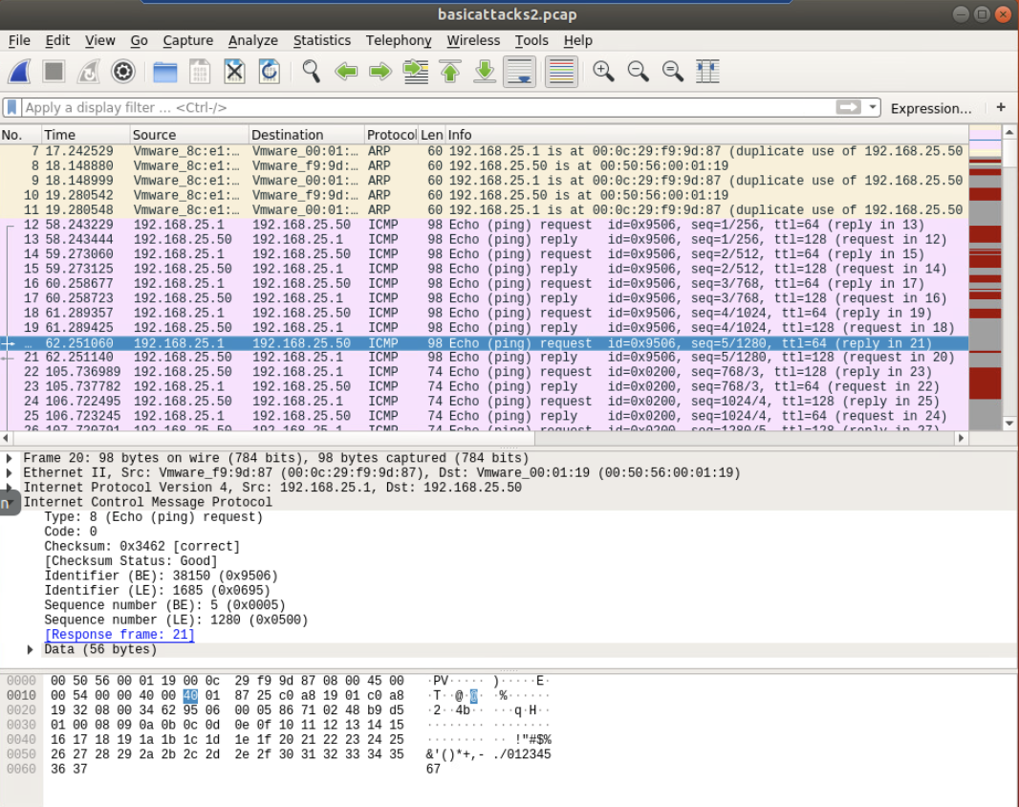
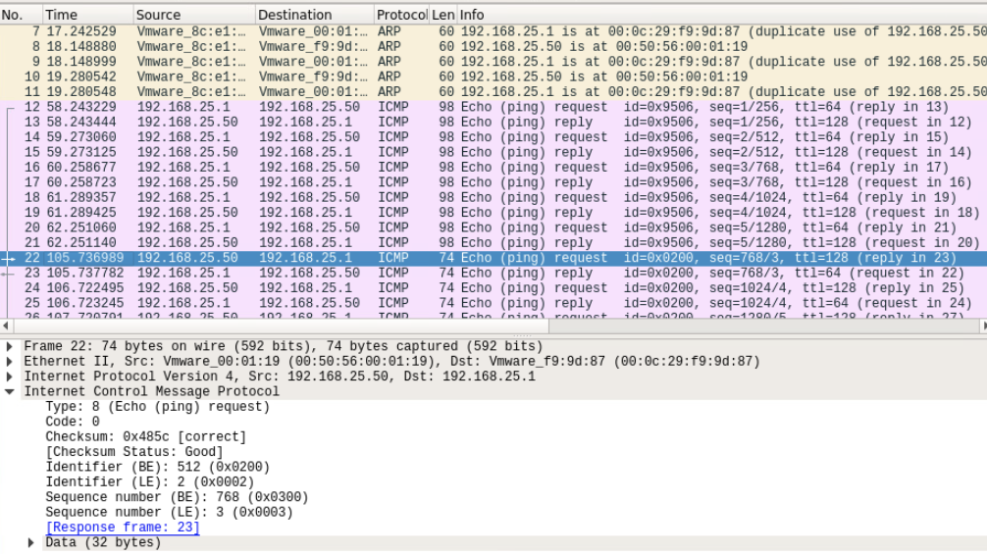
ICMP Packet Comparison and OS Identification
Analyzed ICMP captures 20 and 22 to compare packet structure and operating system behavior
Capture 20: TTL = 64, Data = 56 bytes
Capture 22: TTL = 128, Data = 32 bytes
Differences in time-to-live (TTL) and payload size indicate packets originated from different systems
The echo request in Capture 20 was generated by a Linux/Unix or macOS host, which uses a default TTL of 64 and a 56-byte payload
Capture 22 likely originated from a Windows-based system, using the higher TTL and smaller data field

Slide 5
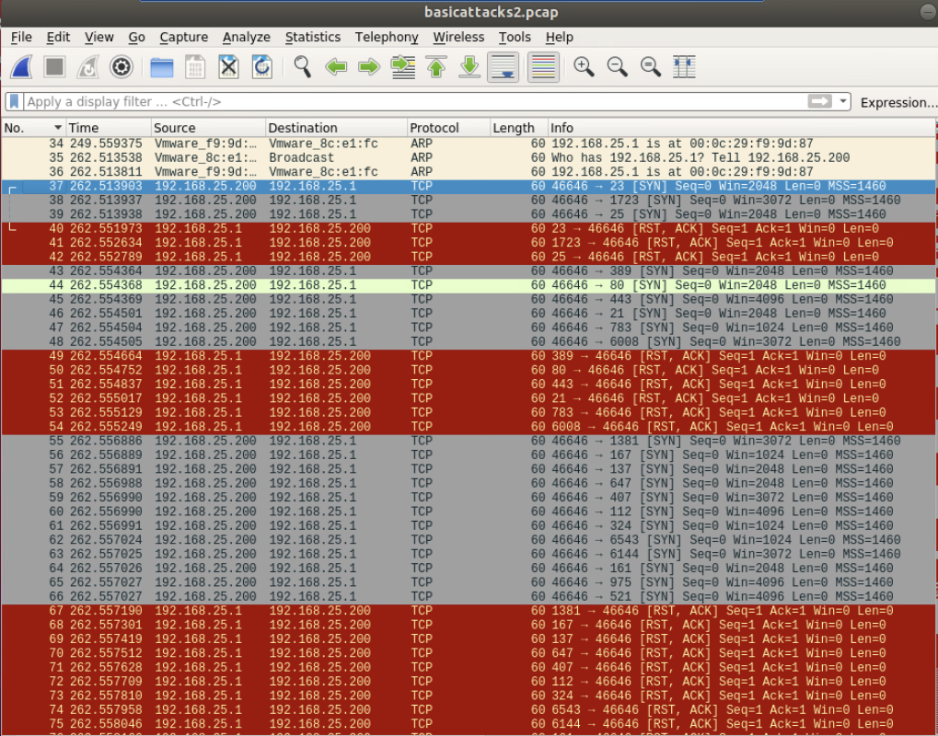
TCP Port Scan Detection
Beginning at packet 37, multiple SYN packets are sent from 192.168.25.200 to various destination ports on 192.168.25.1
The target system responds with RST/ACK packets, indicating that the probed ports are closed
This repeated SYN activity is characteristic of a TCP port scan, a technique used by attackers to identify open or responsive services on a host
The behavior suggests an attempt to map available network services prior to exploitation or further probing

Slide 6
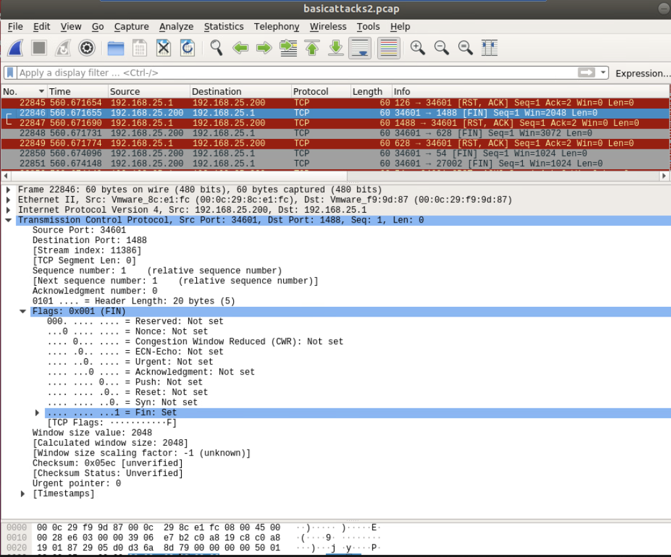
Stealth FIN Scan Identification
Packet 22846 contains the FIN flag despite no active TCP session being established.
This behavior is unusual, since the FIN flag is typically used only to terminate a valid TCP connection.
The presence of standalone FIN packets indicates a stealth FIN scan, where the attacker sends FIN probes to identify open ports without initiating a full handshake.
Such scans are designed to bypass basic detection systems and gather reconnaissance on active services discreetly.

Slide 7
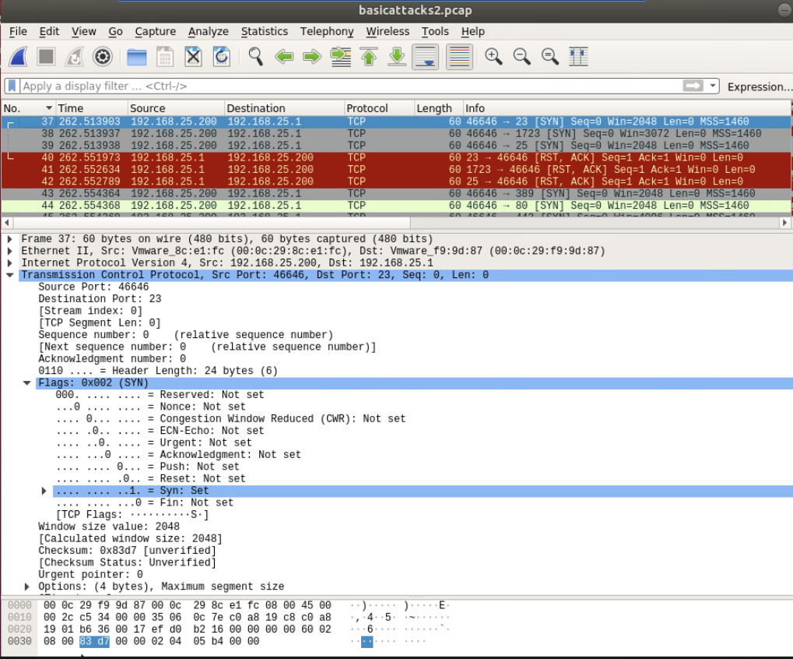
Target Host Identification
Analysis confirms the targeted host IP address is 192.168.25.1
Multiple captured packets show consistent destination traffic to this address, indicating it is the focus of the scan activity
The pattern of repeated connections aligns with network reconnaissance behavior, where an attacker systematically probes a single host to determine active ports or services

Slide 8

OpenSSL Encryption & Certificate Management
Generating and testing SSL/TLS certificates to secure encrypted communication between client and server.

Slide 9
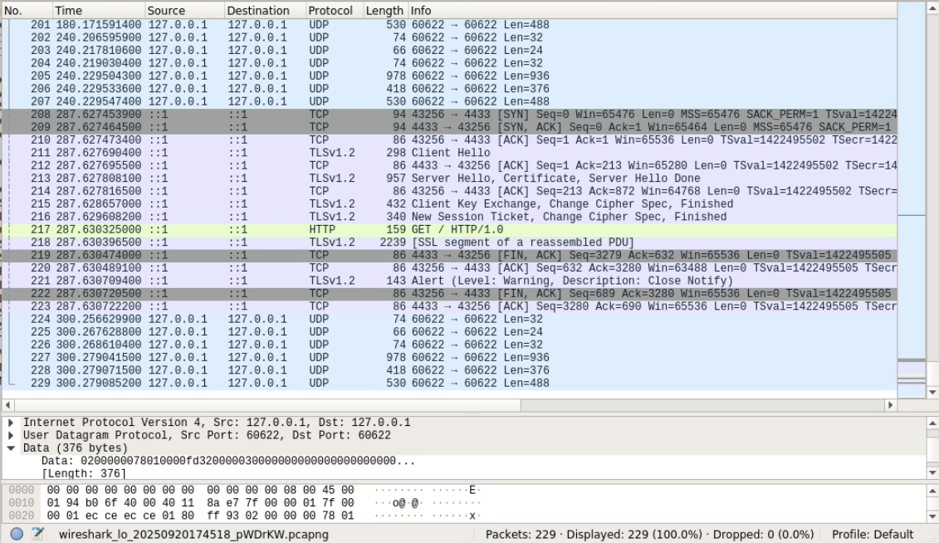
Creating & Testing an SSL/TLS file
GET request captured after retrying with TLS 1.2
Successful exchange confirms a completed SSL/TLS handshake
Secure traffic established and flowing between client and server

Slide 10
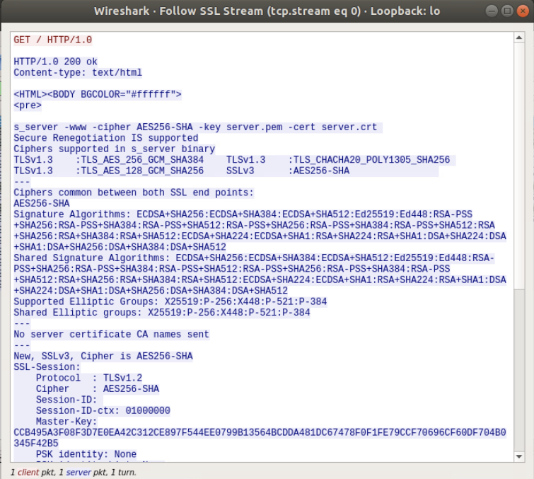
Decrypted SSL/TLS Session Analysis
SSL stream decrypted and displayed in Wireshark
Private key loaded to reveal the GET request, server response, and cipher suite (AES256-SHA)
Confirms successful session decryption and secure communication

Slide 11
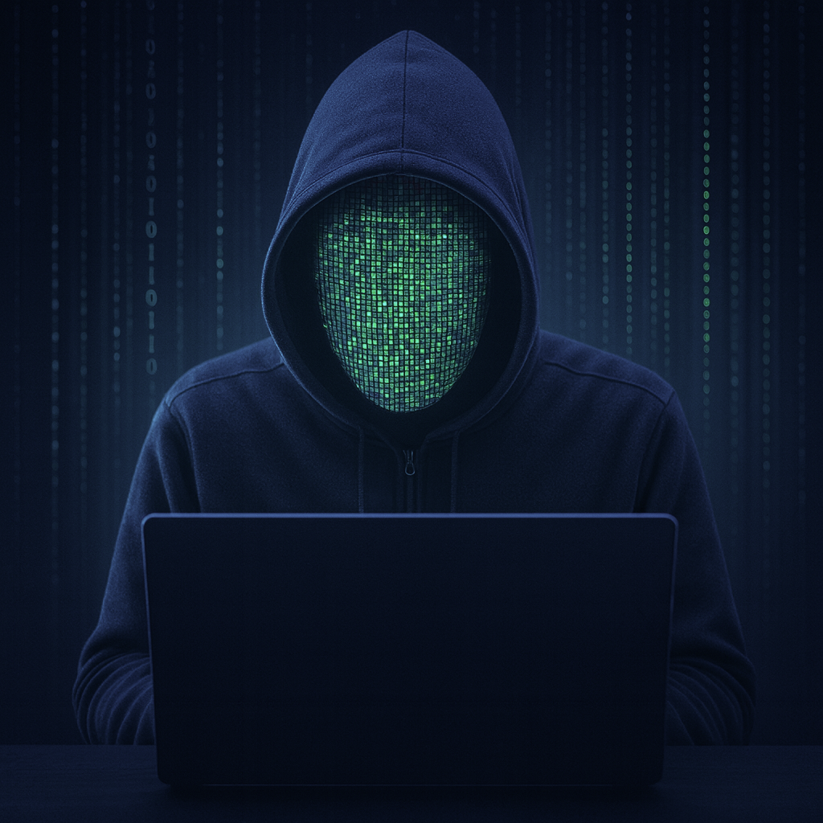
Snort Intrusion Detection and Rule Configuration
Implementing and testing custom Snort rules to detect and log suspicious network activity in real time.

Slide 12
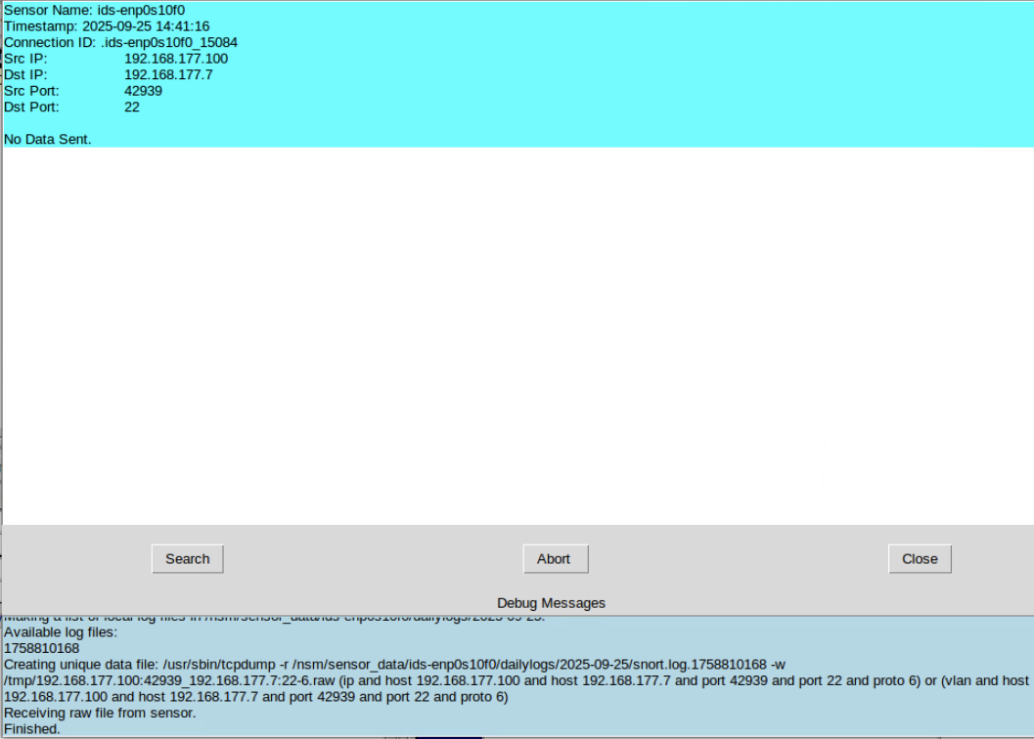
Snort Rule Testing
XMAS scan detected on port 22
Logged connection between 192.168.177.100 and 192.168.177.7
Confirms Snort successfully identifying scan activity

Slide 13
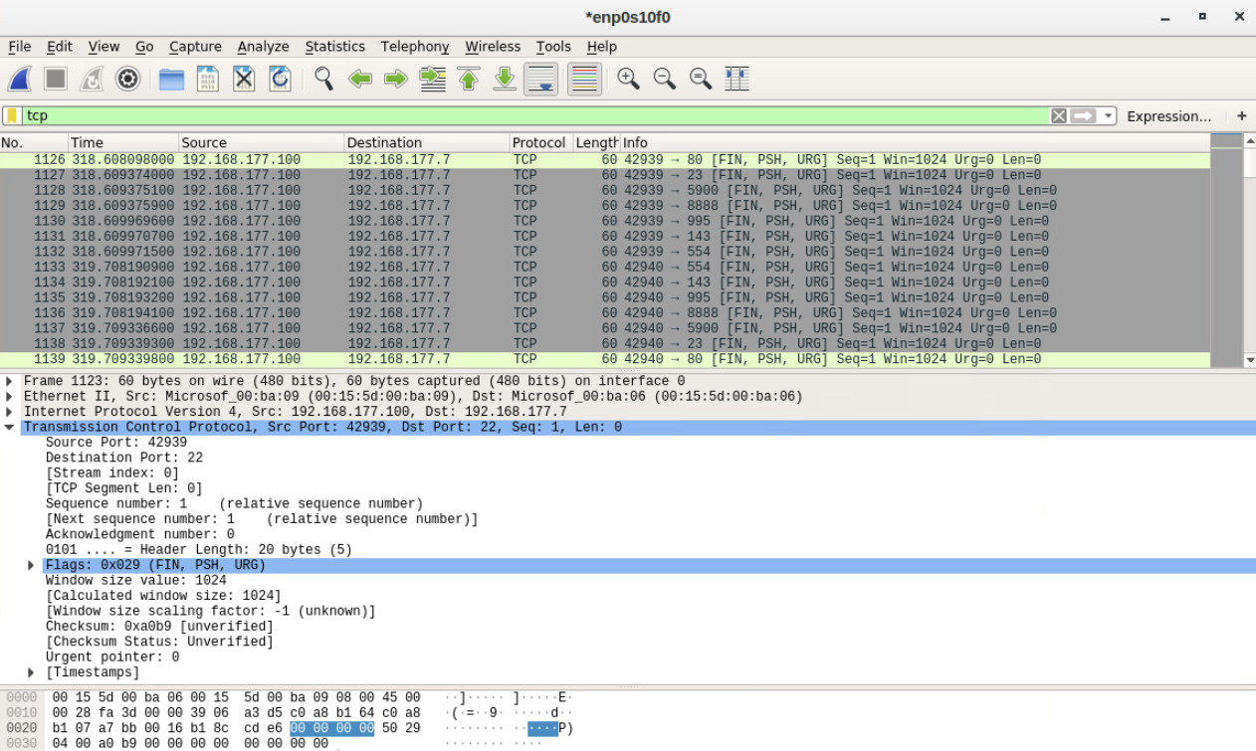
Snort Rule Verification
Wireshark capture shows network scan packets
Abnormal TCP flags (FIN, PSH, URG) confirm XMAS scan behavior
Provides packet-level verification of Snort detection

Slide 14
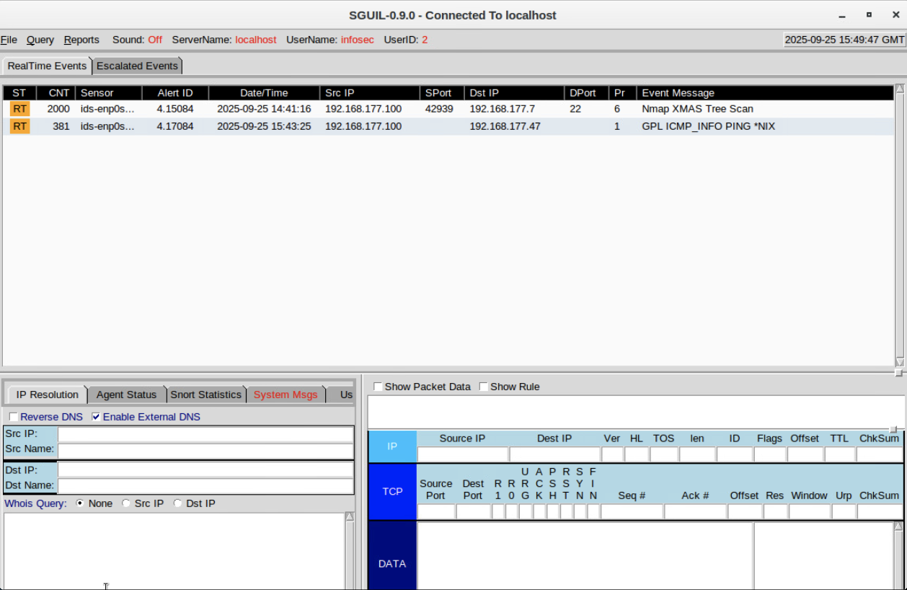
Creating a Custom Snort rule
Custom ICMP ping rule developed to detect echo requests.
Alert triggered when ping traffic detected.
SGUIL dashboard confirmed successful rule activation.

Slide 15
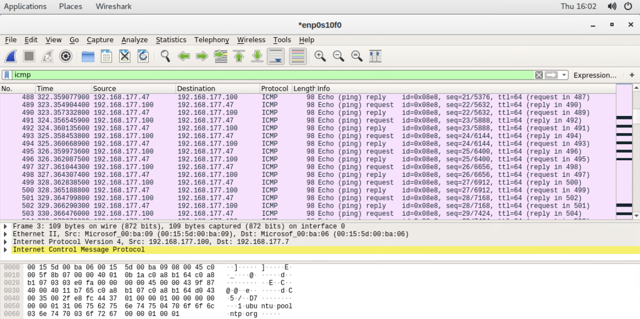
Confirming the Custom Rule
Wireshark capture displays ICMP echo requests and replies
Confirms rule matched real network traffic as intended
Demonstrates effective integration between Snort and Wireshark

Slide 16

Live Memory Analysis
Examining captured system memory to identify running processes, network activity, and potential indicators of compromise.

Slide 17
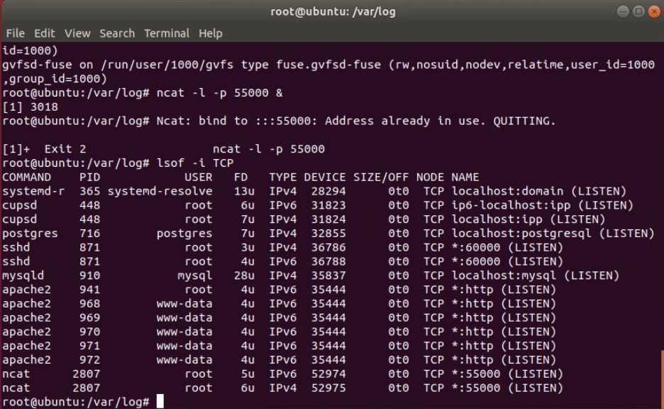
Linux Network Processes
Port 55000 opened with ncat
Confirmed with lsof -i TCP on IPv4 and IPv6
Demonstrates method for identifying open network connections and services in use

Slide 18
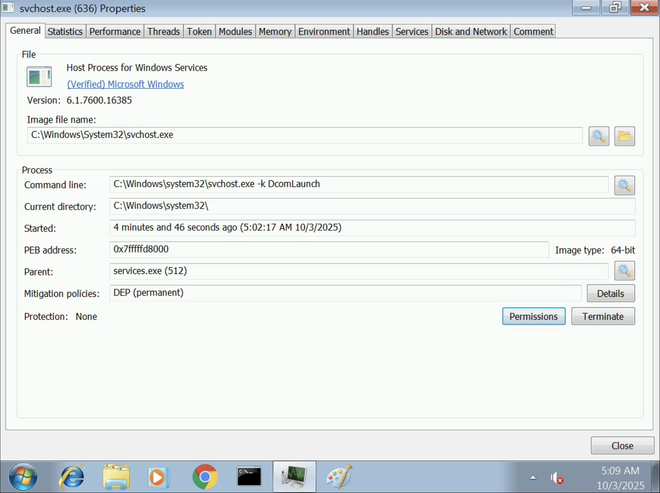
Process
Hacker
Inspected svchost.exe and parent services.exe
Verified DEP policy applied
Used to detect suspicious or injected processes

Slide 19
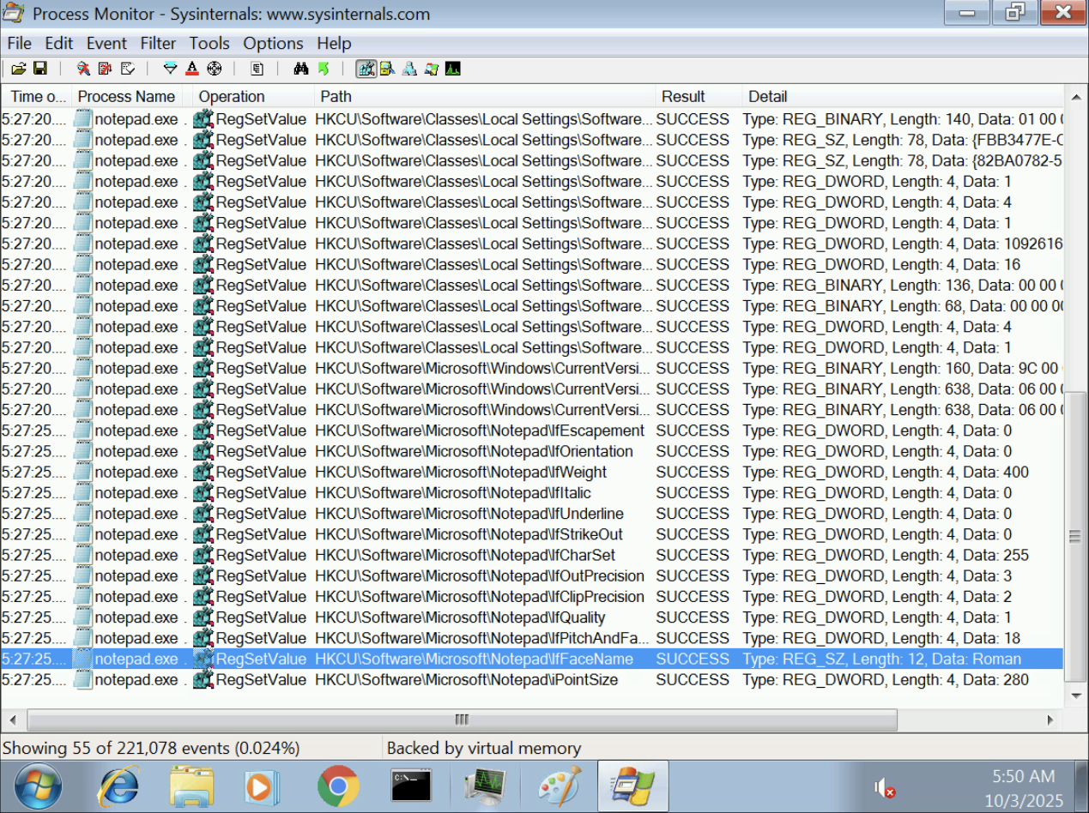
Process Monitor
Monitored registry activity of notepad.exe using Process Monitor
Detected font change to Roman size 28, under:
HKCU\Software\Microsoft\Notepad
Demonstrates how applications modify and store configurations in the Windows Registry

Slide 20

Firewall Design and Implementation
Configuring and testing firewall rules to control network traffic and protect systems from unauthorized access

Slide 21
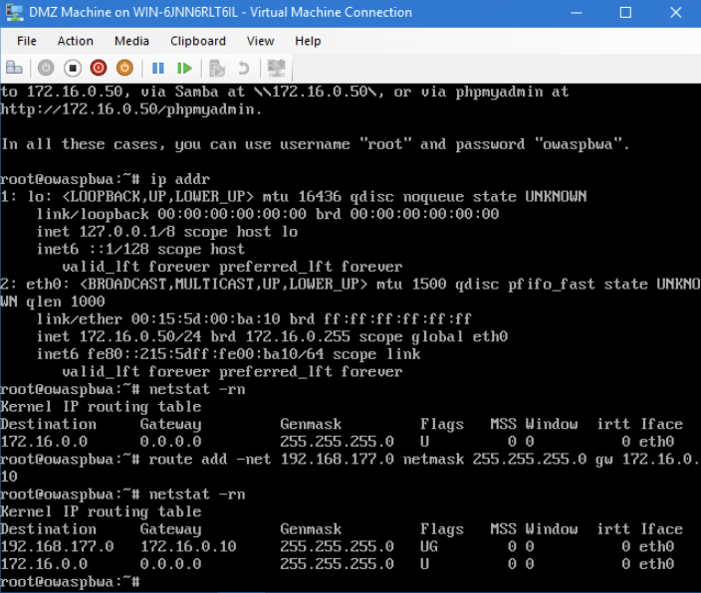
Firewall Design
and Implementation
Verified DMZ routing configuration
Displayed ip addr and netstat -rn outputs
Added static route to reach 192.168.177.0/24 via 172.16.0.10
Confirmed correct gateway and route entries

Slide 22
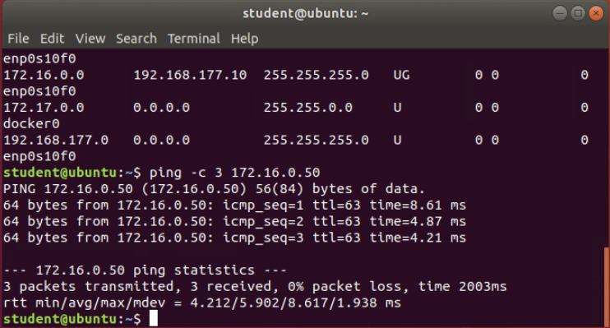
Firewall Connectivity Testing
Enabled IP forwarding (net.ipv4.ip_forward=1)
Verified connectivity using ping (0% loss)
Ran SYN scan: sudo nmap -sS 172.16.0.50
Identified open ports for firewall rule creation

Slide 23
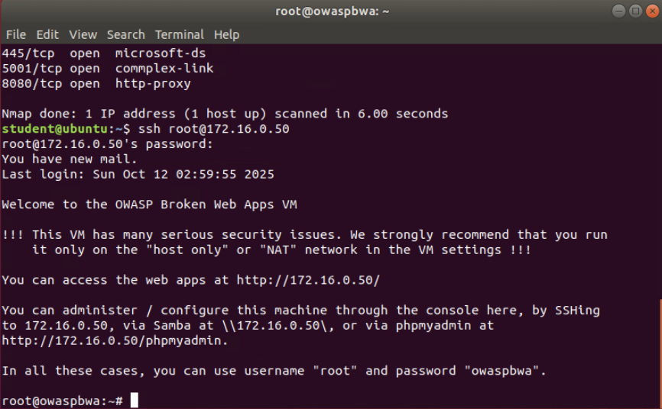
Firewall Rule Implementation
Scanned DMZ host with nmap to identify open ports
Configured iptables for time-restricted SSH (08:00–16:00 CST)
Verified firewall time settings with timedatectl
Confirmed SSH access within allowed window

Slide 24

Challenges
Some virtual machines ran slow, and the mouse consistently disappeared, requiring restarts to continue labs
Balancing multiple projects and tight deadlines required strong focus, patience, and time management
Fine-tuning configurations (firewall rules and analysis tools) required precision and adaptability
Learning how to communicate my technical findings so that both general and technical audiences could understand and appreciate them

Slide 25

Career Skills
Built hands-on experience in network defense, intrusion detection, and system hardening using industry-standard tools (Wireshark, Snort, OpenSSL, iptables).
Strengthened Linux and Windows command-line proficiency for real-time analysis and forensic investigation.
Applied critical thinking and threat-modeling skills to identify vulnerabilities and implement secure configurations.
Developed a proactive mindset toward emerging security challenges and continuous professional learning.
Communicated technical findings clearly to both technical and general audiences

Slide 26

This project gave me valuable, hands-on experience using real security tools in realistic scenarios. I learned how to secure systems, trace network activity, and recognize potential threats while building a stronger sense of confidence and control. The work reinforced my attention to detail, problem-solving ability, and dedication to keeping networks safe.

Slide 27
References
Intrusion Analysis using Wireshark
Gowthamraj, F. (2025). Understanding the ICMP Protocol with Wireshark. Cisco Learning Network.
https://learningnetwork.cisco.com/s/article/Understanding-the-ICMP-Protocol-with-Wireshark-in-Real-Time
Port Scanning Techniques. Nmap Network Mapper. https://nmap.org/book/man-port-scanning-techniques.html
Wireshark User’s Guide. Wireshark Foundation. https://www.wireshark.org/docs/wsug_html/
OpenSSL Encryption and
Certificate Management
OpenSSL Software Foundation. OpenSSL: Cryptography and SSL/TLS Toolkit. https://www.openssl.org/docs/
Wireshark User’s Guide. Wireshark Foundation. https://www.wireshark.org/docs/
Live Memory Analysis
Microsoft Docs. (2023). Process Monitor v3.93. Microsoft Learn. https://learn.microsoft.com/en-us/sysinternals/downloads/procmon
Varonis. (2023, June 23). Process Hacker: Advanced Task Manager Overview. https://www.varonis.com/blog/process-hacker
How-To Geek. (2019, April 10). How to Use the Linux lsof Command. https://www.howtogeek.com/426031/how-to-use-the-linux-lsof-command/
Firewall Design and Implementation
Anicas, M. (2024, June 4). Iptables Essentials: Common Firewall Rules and Commands. DigitalOcean. https://www.digitalocean.com/community/tutorials/iptables-essentials-common-firewall-rules-and-commands
Red Hat. (2023, May 17). Using Iptables to Secure Your Linux Server. Red Hat, Inc. https://www.redhat.com/sysadmin/iptables

