Slide 1
Circuit Simulation
CEIS101 Final Course Project
July 2024 Session
Jaclyn Fisher
Prof. Raef Yassin

Slide 2
Introduction
This is a smart home automation and security system prototype. Programmed using a virtual emulator, this project covered the fundamental concept of the IoT by integrating hardware, software, and networks into an entire system.
The smart home system encompasses various devices to monitor the condition of the home. This includes a door sensor to check whether to door is open or closed, a distance sensor to monitor for a home intruder, and automated lights that turn on when it is dark.
Tools used to create this project were Tinkercad, a web app for 3D design, electronics and coding, Microsoft Office and Word, and Microsoft Excel was used to analyze data generated by a distance sensor to make a scatter plot graphs.

Slide 3
CEIS101
Module 2
Circuit Simulation in Tinkercad

Slide 4
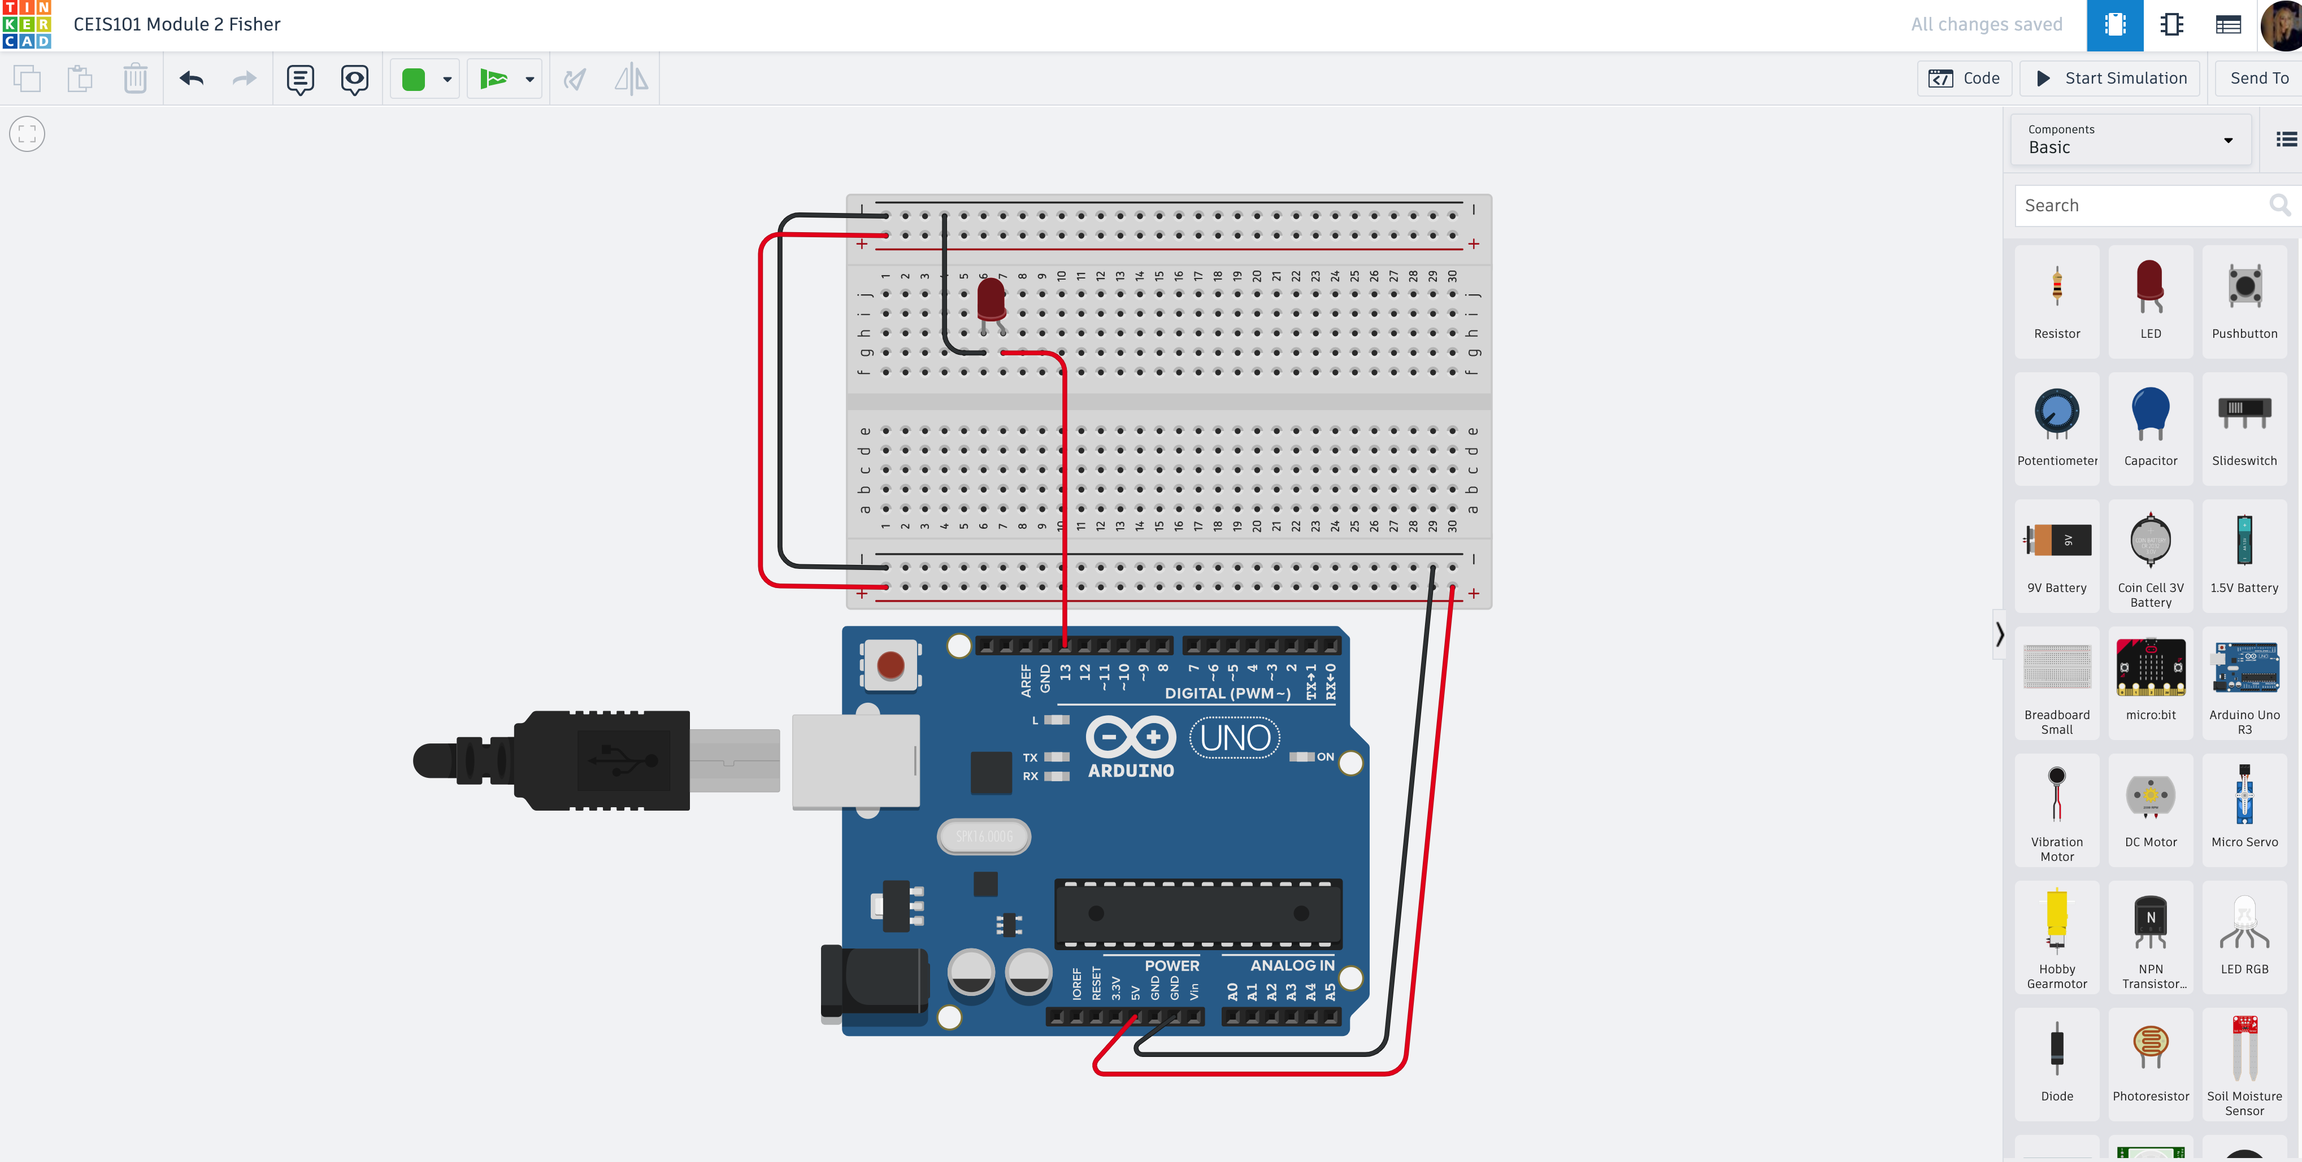
Arduino Circuit (screenshot)

Slide 5
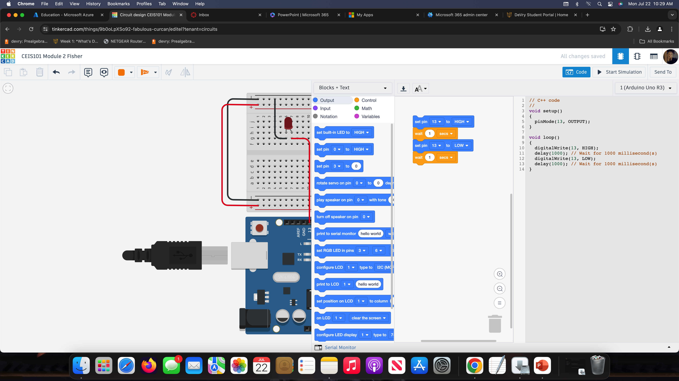
Code (screenshot)

Slide 6
Module 2 Objectives
To introduce simulation using a virtual emulator
To familiarize myself with hardware components required for build.
Familiarize myself with programming logic and design of hardware.
Learn error handling principles in operating system.
An Arduino Uno R3 and a bread board were used for this automated security system prototype.

Slide 7
CEIS101
Module 3
Inventory of Parts, Circuit Building, and Displaying Messages

Slide 8
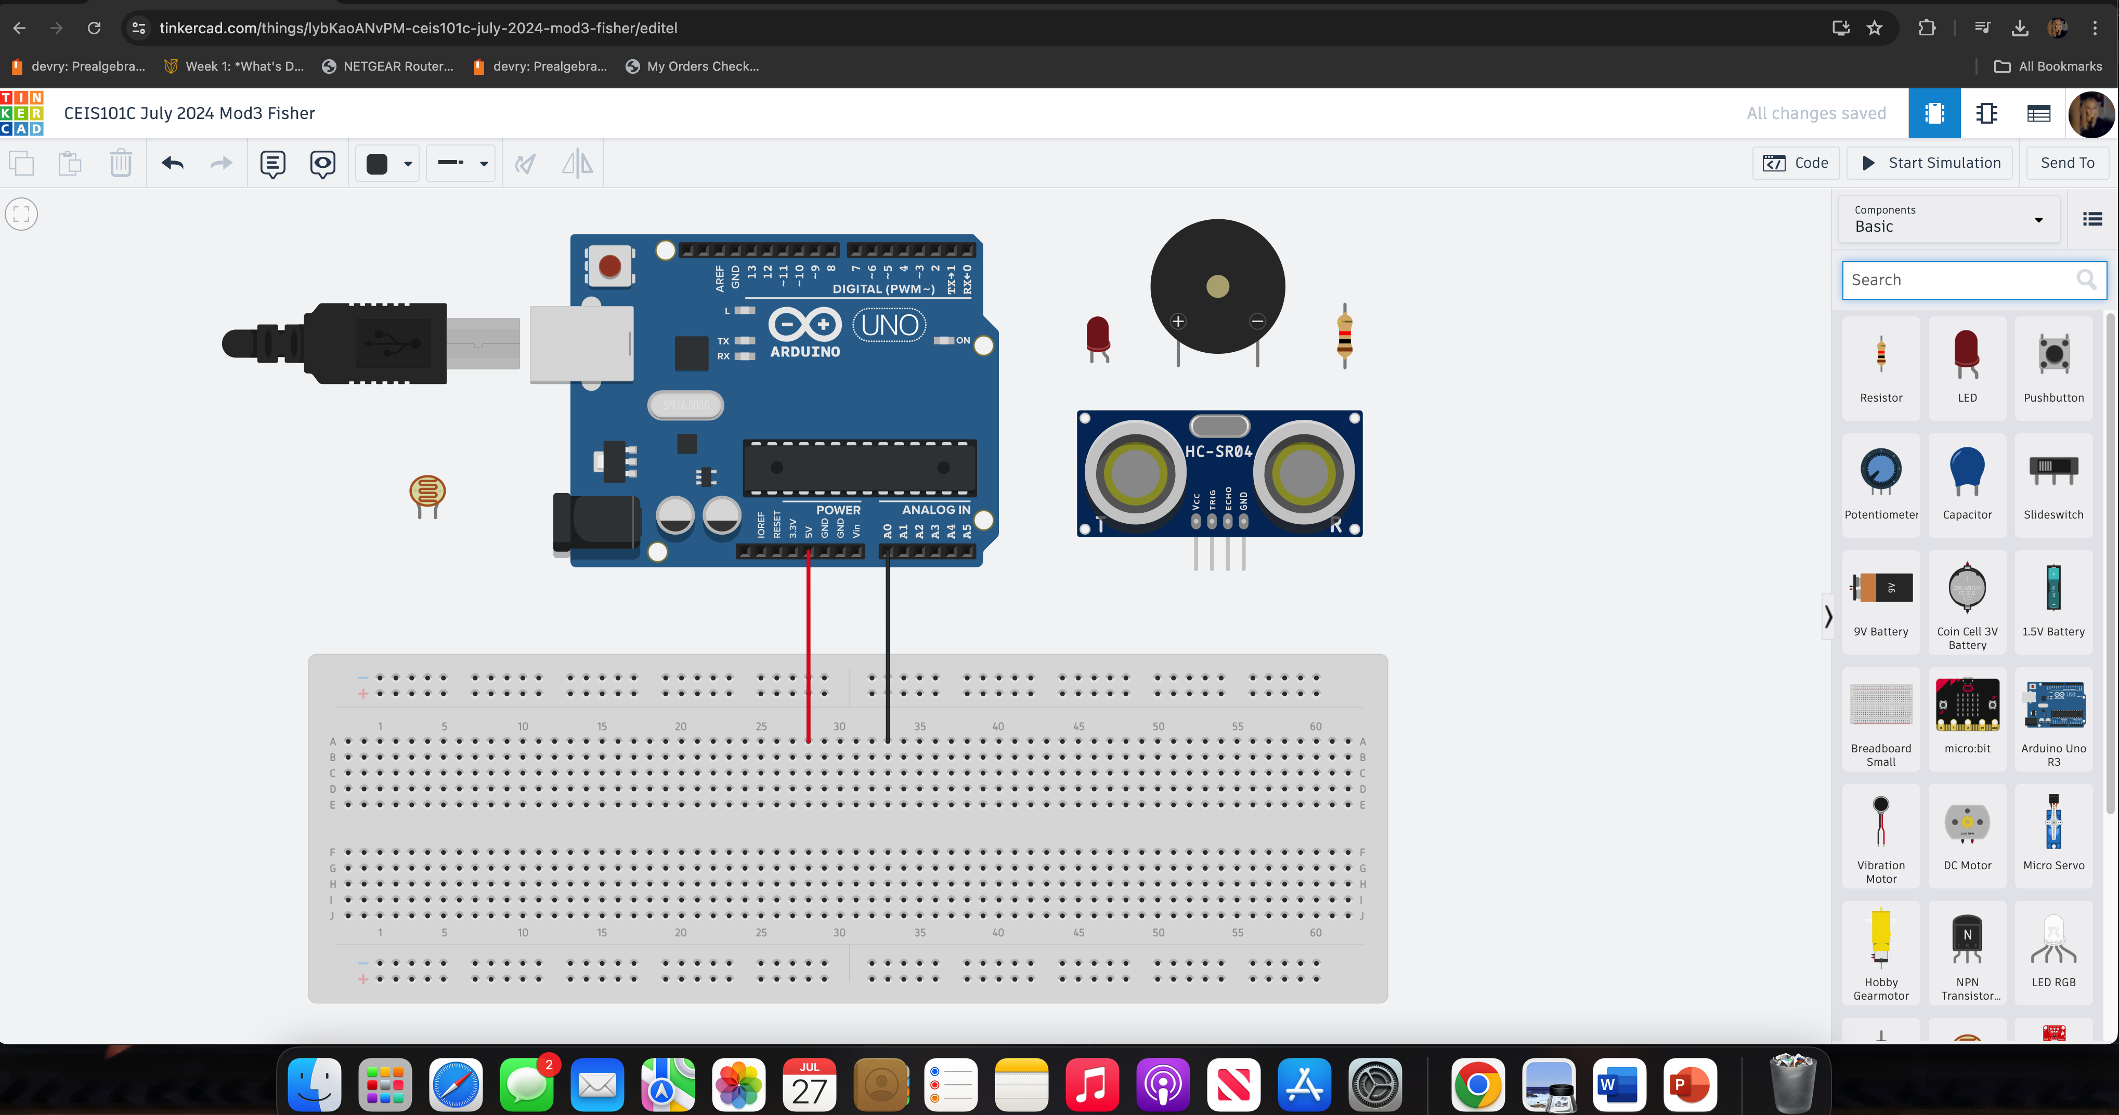
Organization of Project Components
Arduino Uno
Breadboard
Resistor 10kΩ
LEDs
Ultrasonic Sensor
Active Buzzer
Photoresistor
Wires

Slide 9
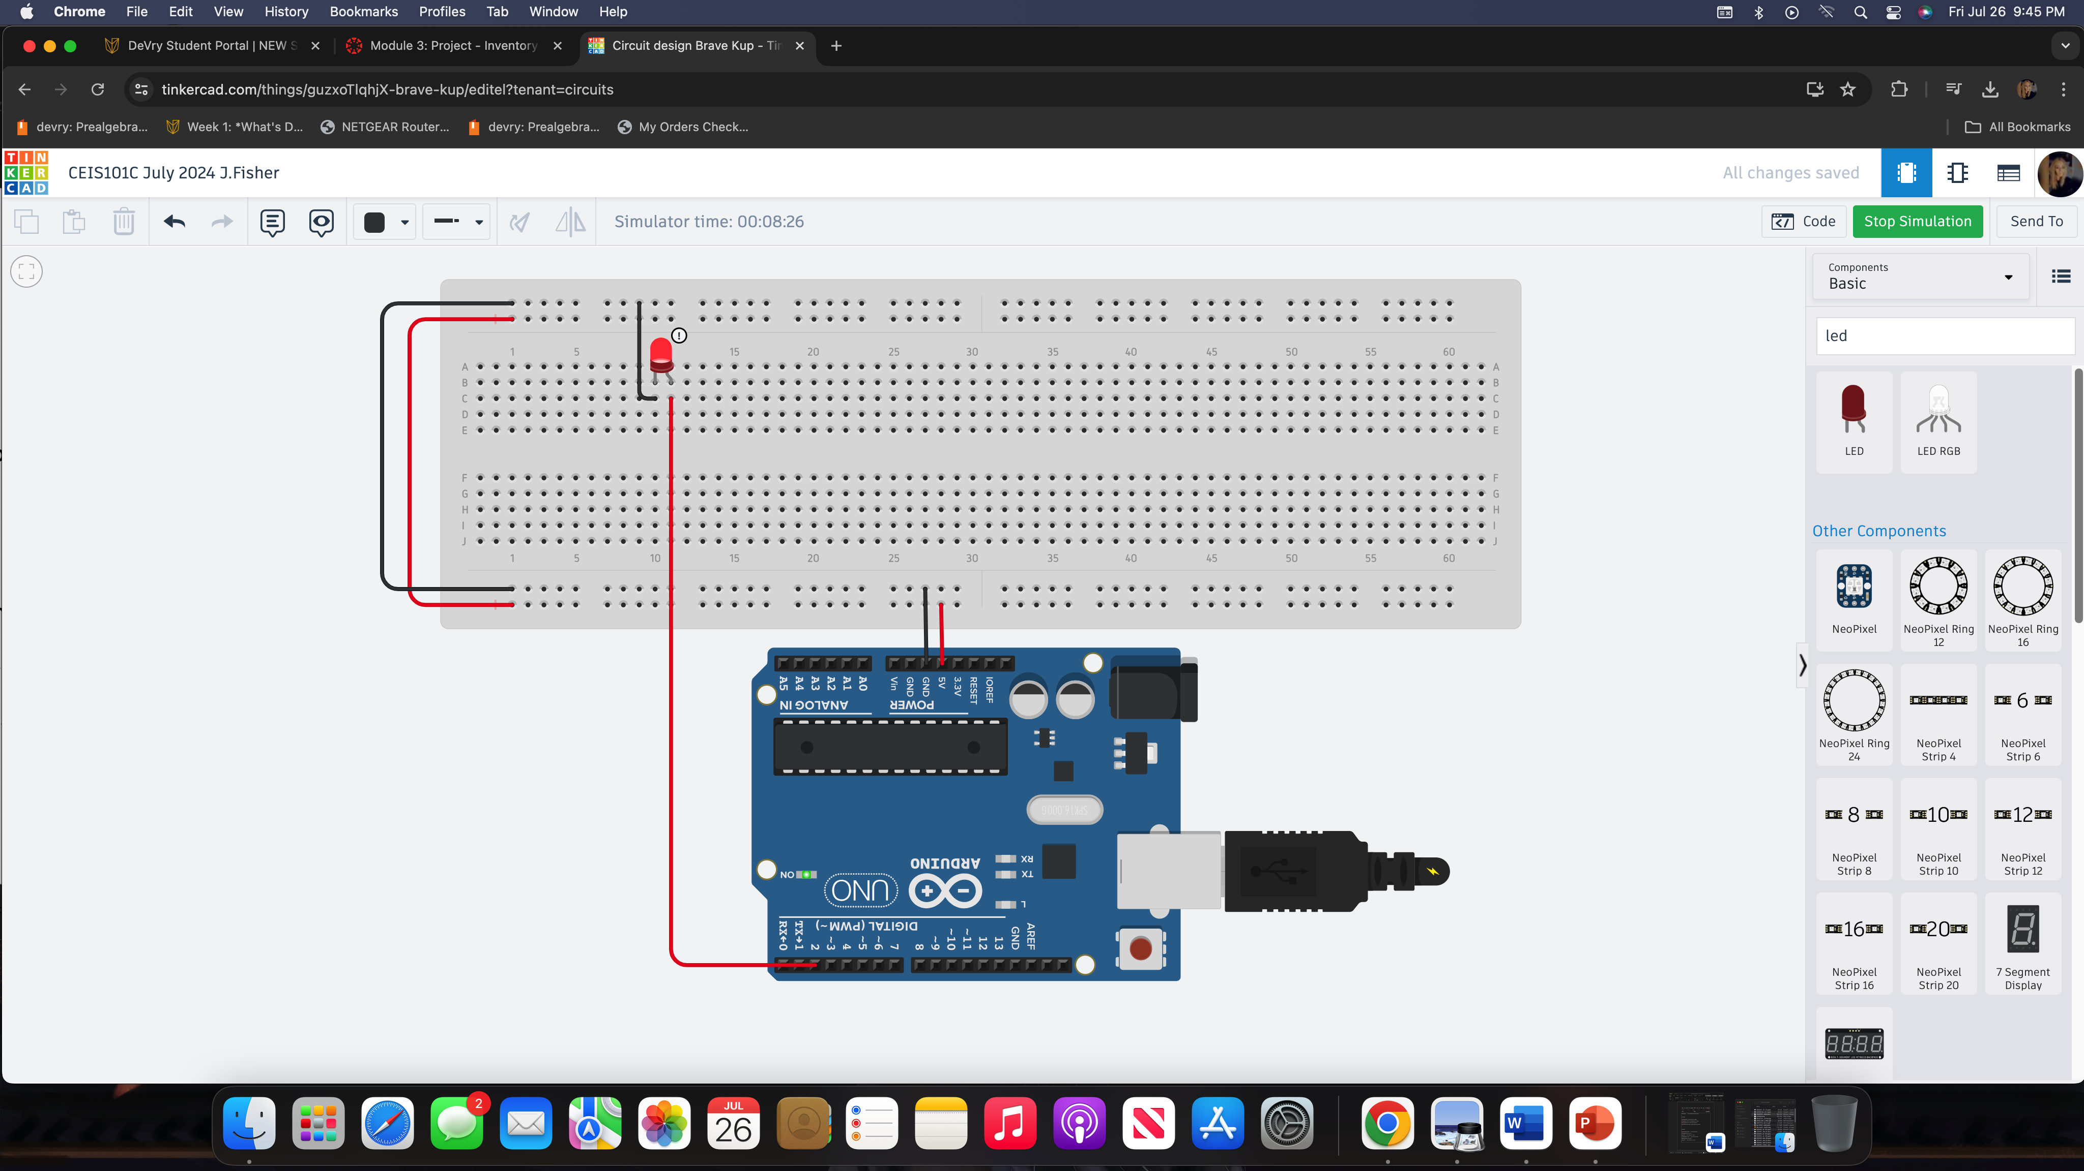
Circuit with red LED turned on

Slide 10
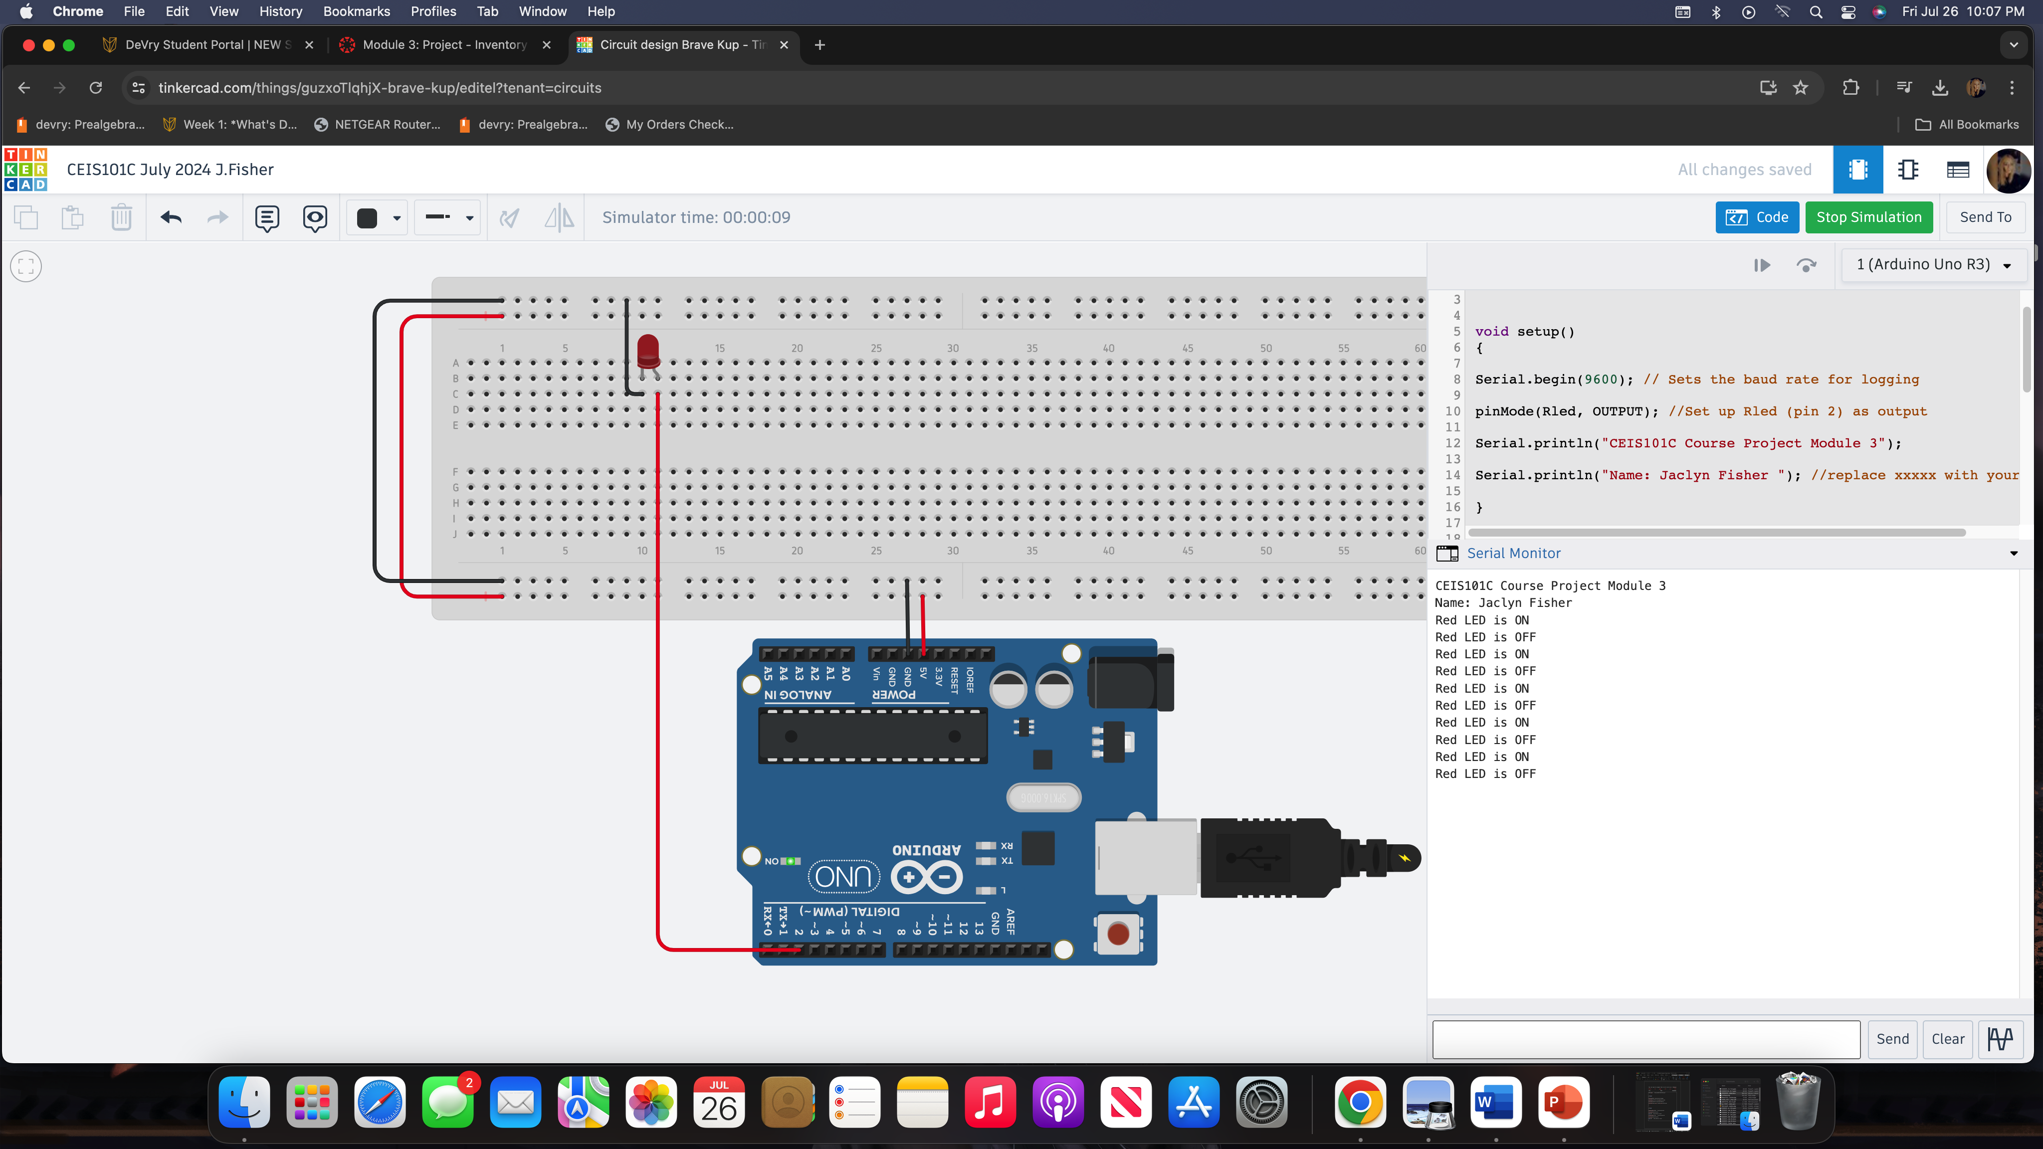
Serial Monitor (screenshot)

Slide 11
Module 3 Objectives
Familiarize myself with hardware components for course project.
To learn how to build circuits with LEDs (Light Emitting Diode).
Learn how to program LEDs.
Learn how to initialize the Serial Monitor.
Learn how to send messages to the Serial Monitor.

Slide 12
CEIS101
Module 4
Adding Door Sensor to Smart Home System

Slide 13
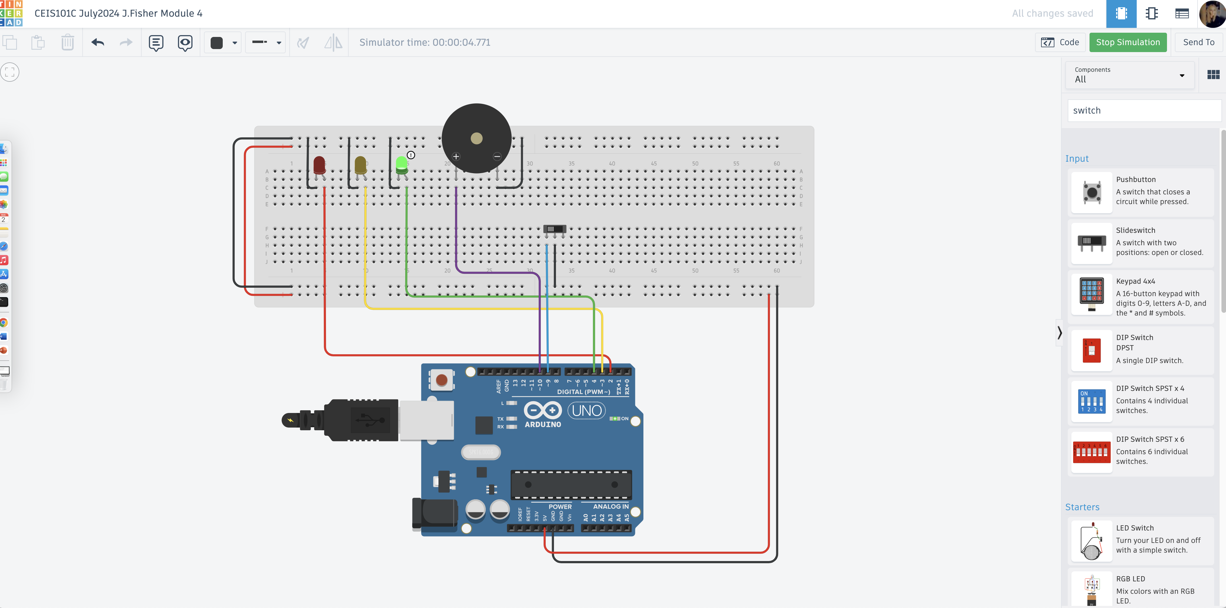
Circuit of door closed with Green LED ON

Slide 14
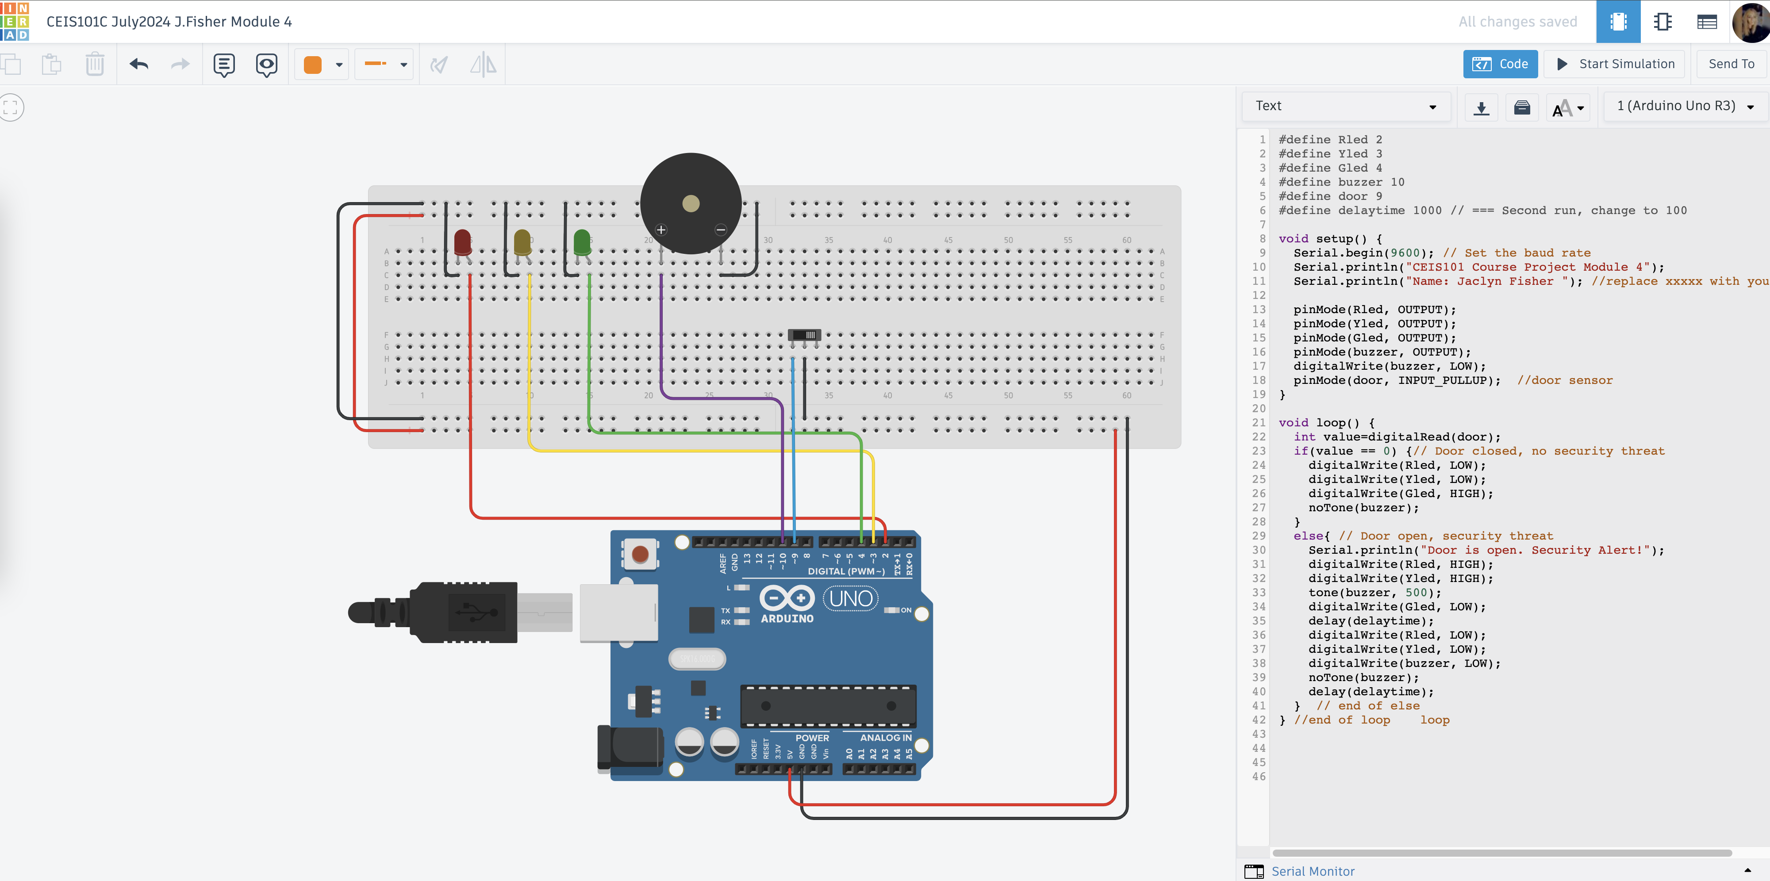
Arduino Code (screenshot)

Slide 15
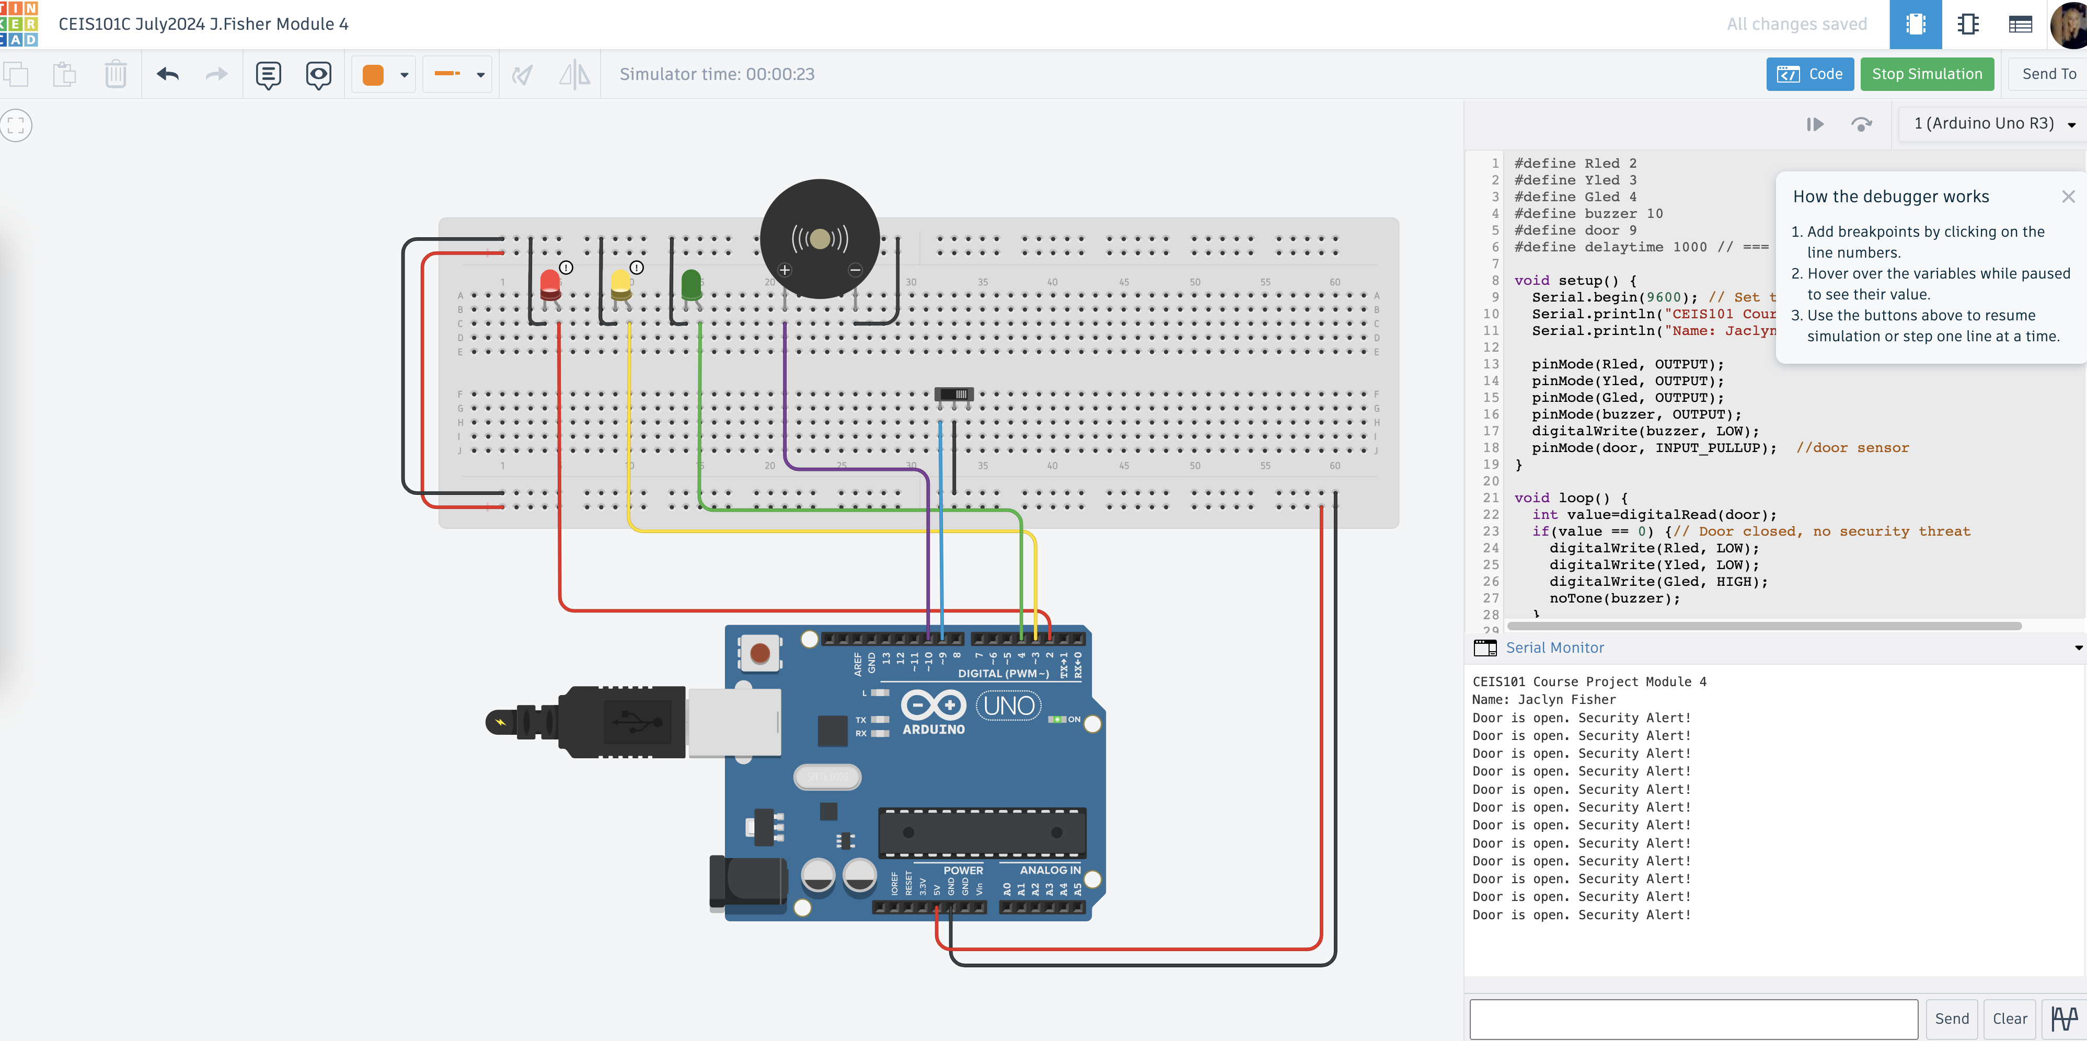
Serial Monitor (screenshot)

Slide 16
Module 4 Objectives
To learn how to connect multiple LEDs and a buzzer to the Arduino Board.
Learn how to use a wire to emulate an open or closed door.
To integrate an alarm into a security system.
Pay attention and familiarize myself with conditional programming instructions.

Slide 17
CEIS101
Module 5
Adding Distance Sensor to Smart Home System
and Conducting Data Analysis

Slide 18
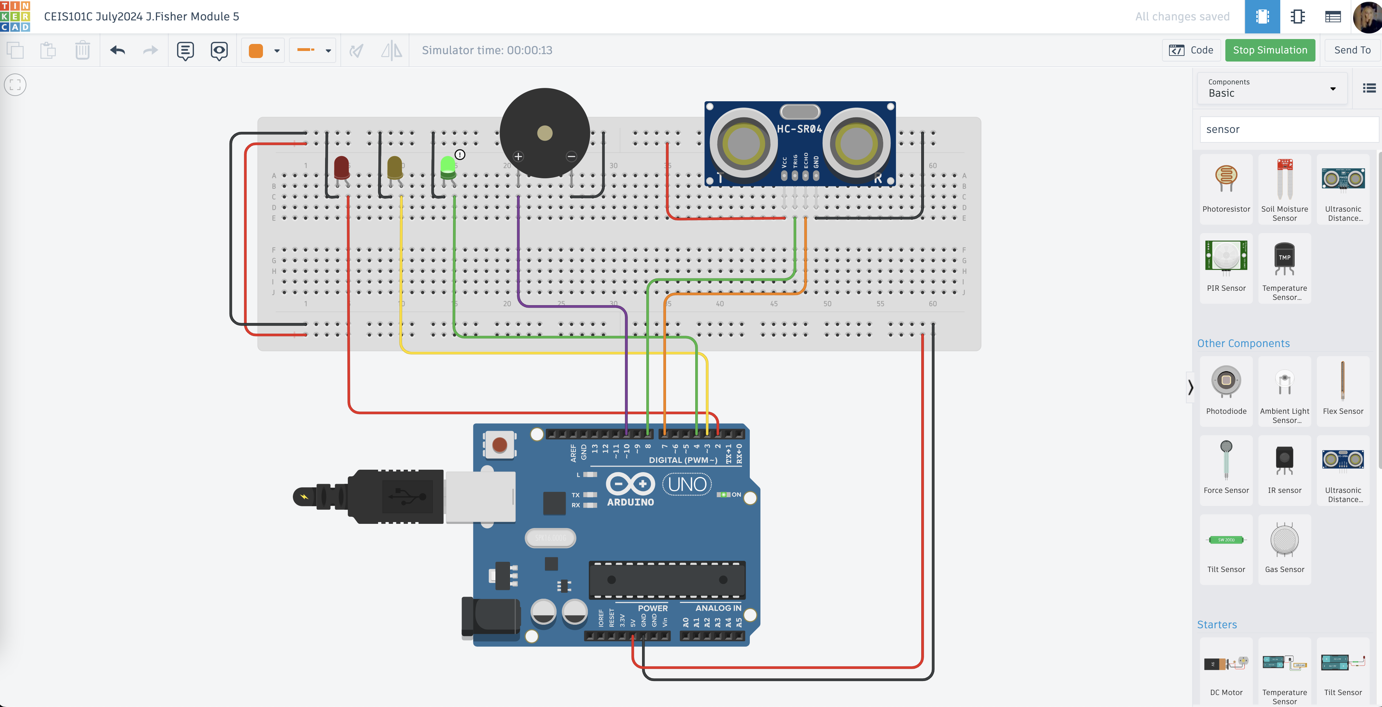
Circuit with green LED on

Slide 19
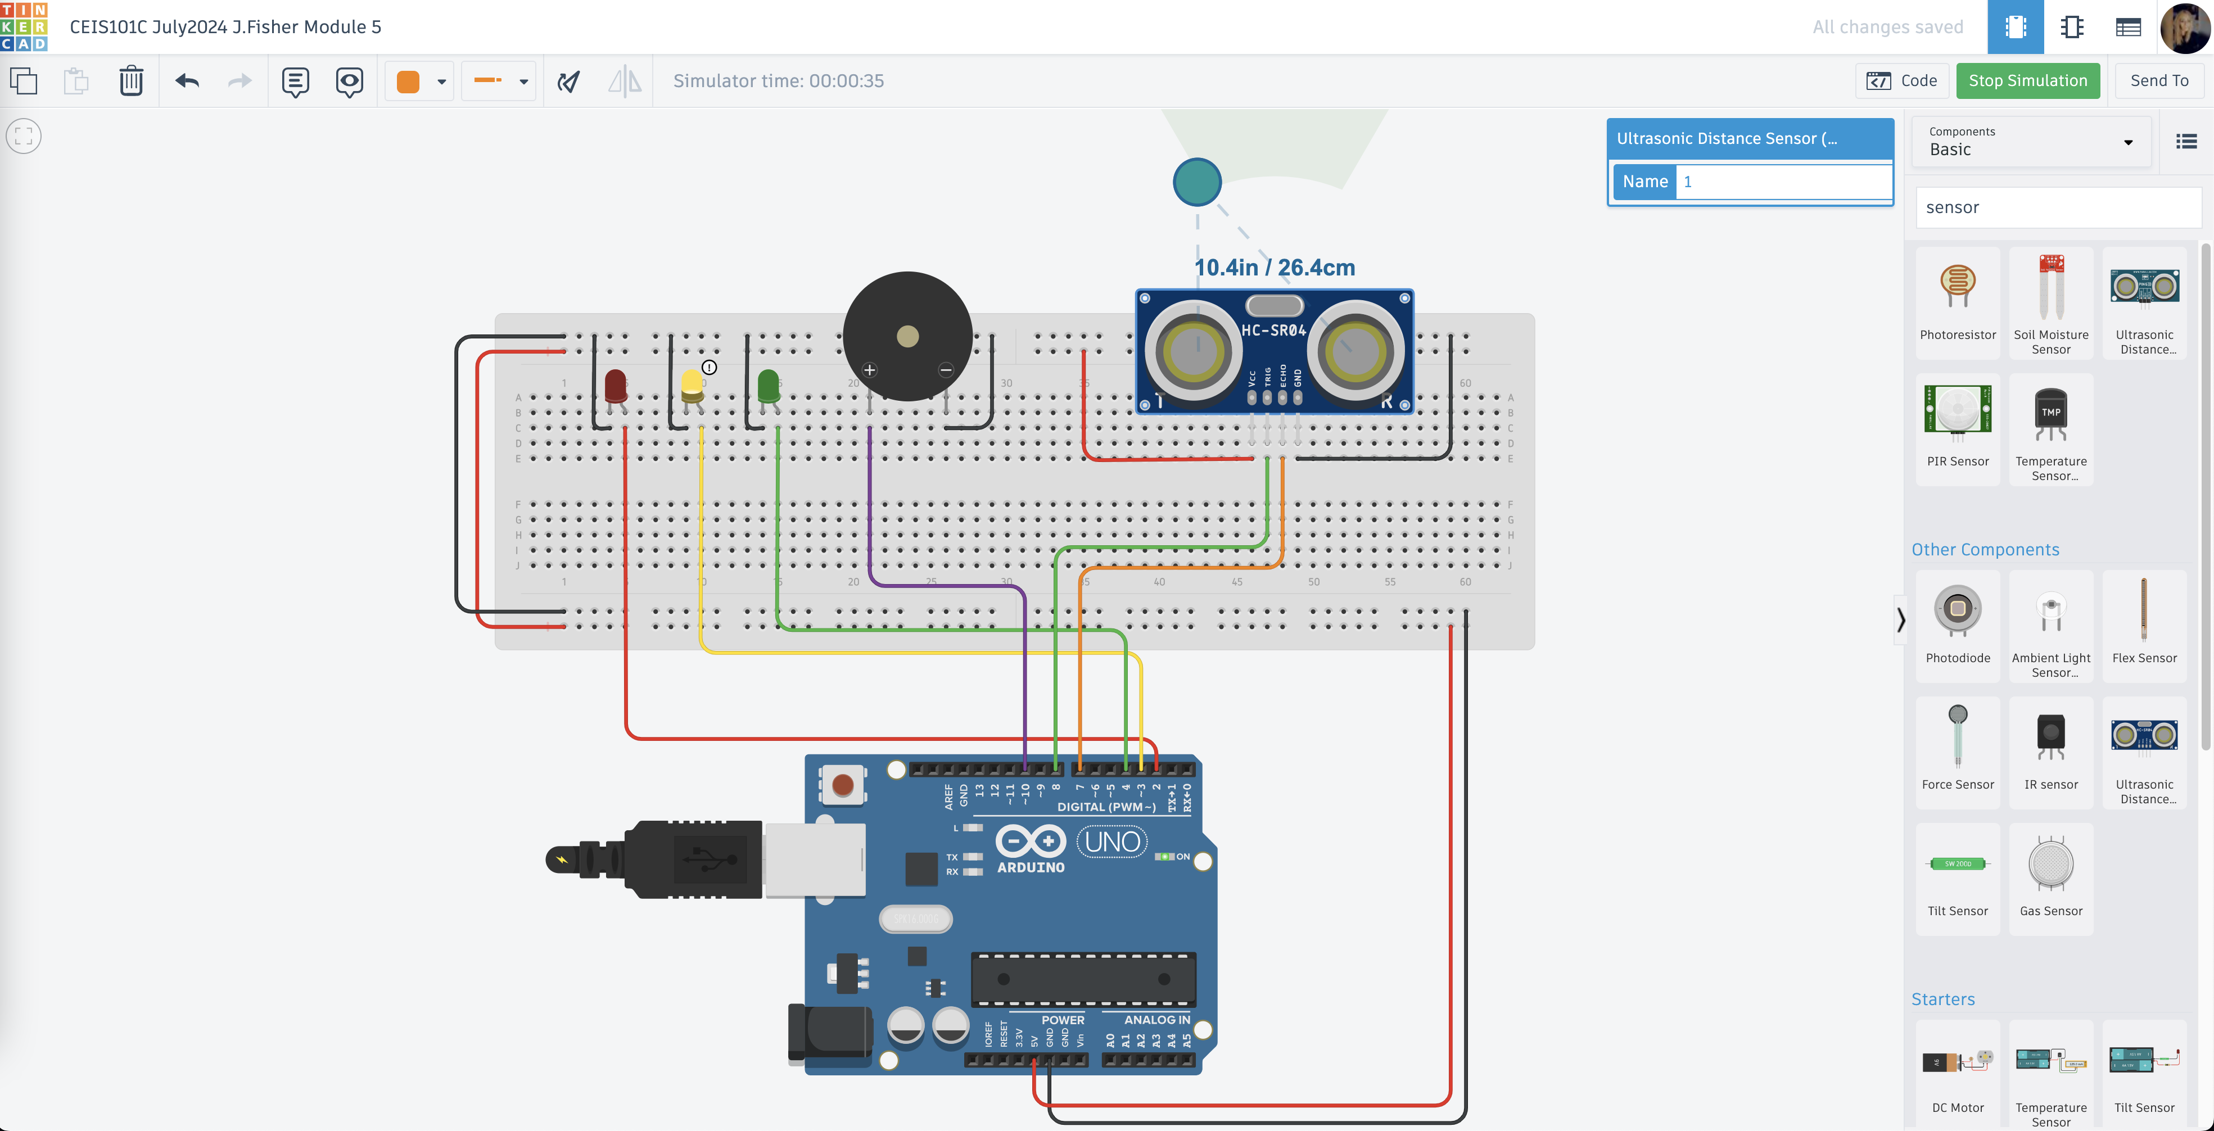
Circuit with yellow LED on

Slide 20

Circuit with red LED on

Slide 21
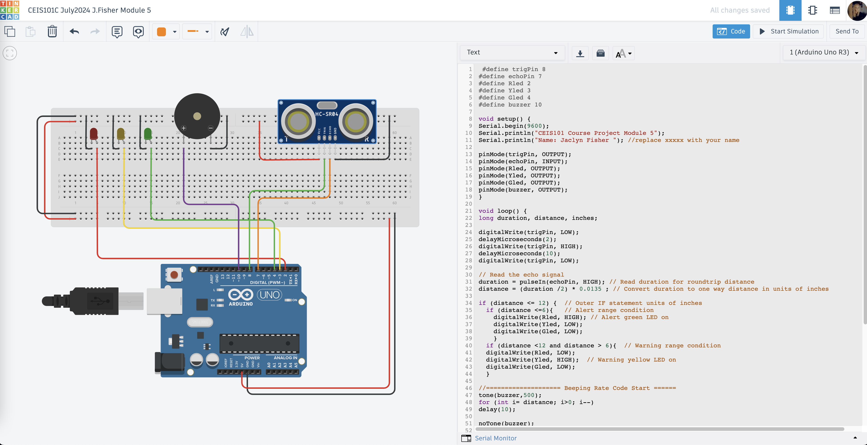
Arduino Code (screenshot)

Slide 22
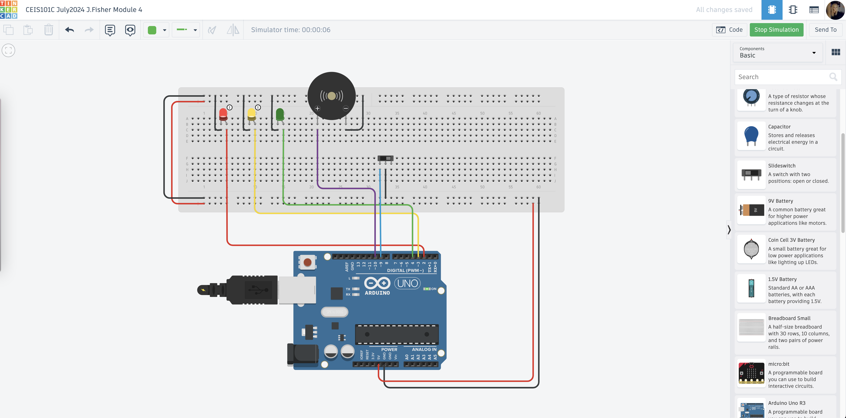
Circuit of door open with Green LED OFF

Slide 23
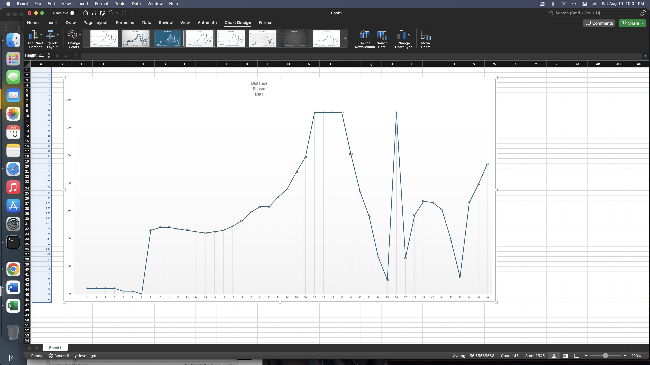
Plot of data (graph from Excel)

Slide 24
Module 5 Objectives
To learn how to connect an ultrasonic range finder to the Arduino board.
Learn how to write code that uses an ultrasonic range finder.
How to write code that makes the buzzer produce sounds.
Learn how to display data to the Toggle plotter.
Analyze plot of data generated by sensors, using visual representation from scatter plot graphs by Microsoft Excel.

Slide 25
CEIS101
Module 6
Adding Automated Light to Smart Home System

Slide 26
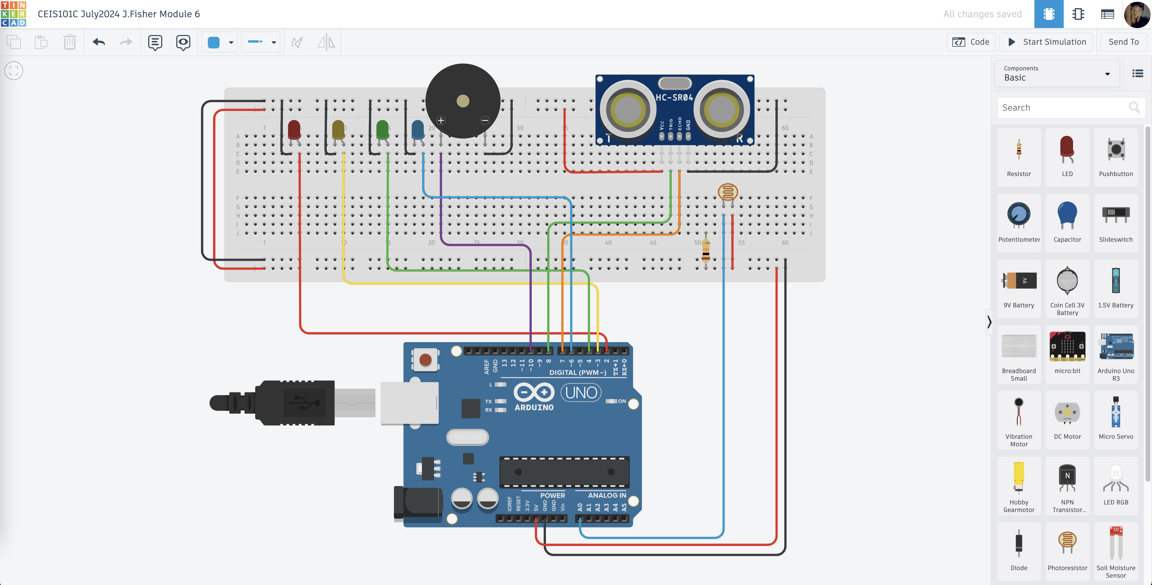
Circuit with automated LED off

Slide 27
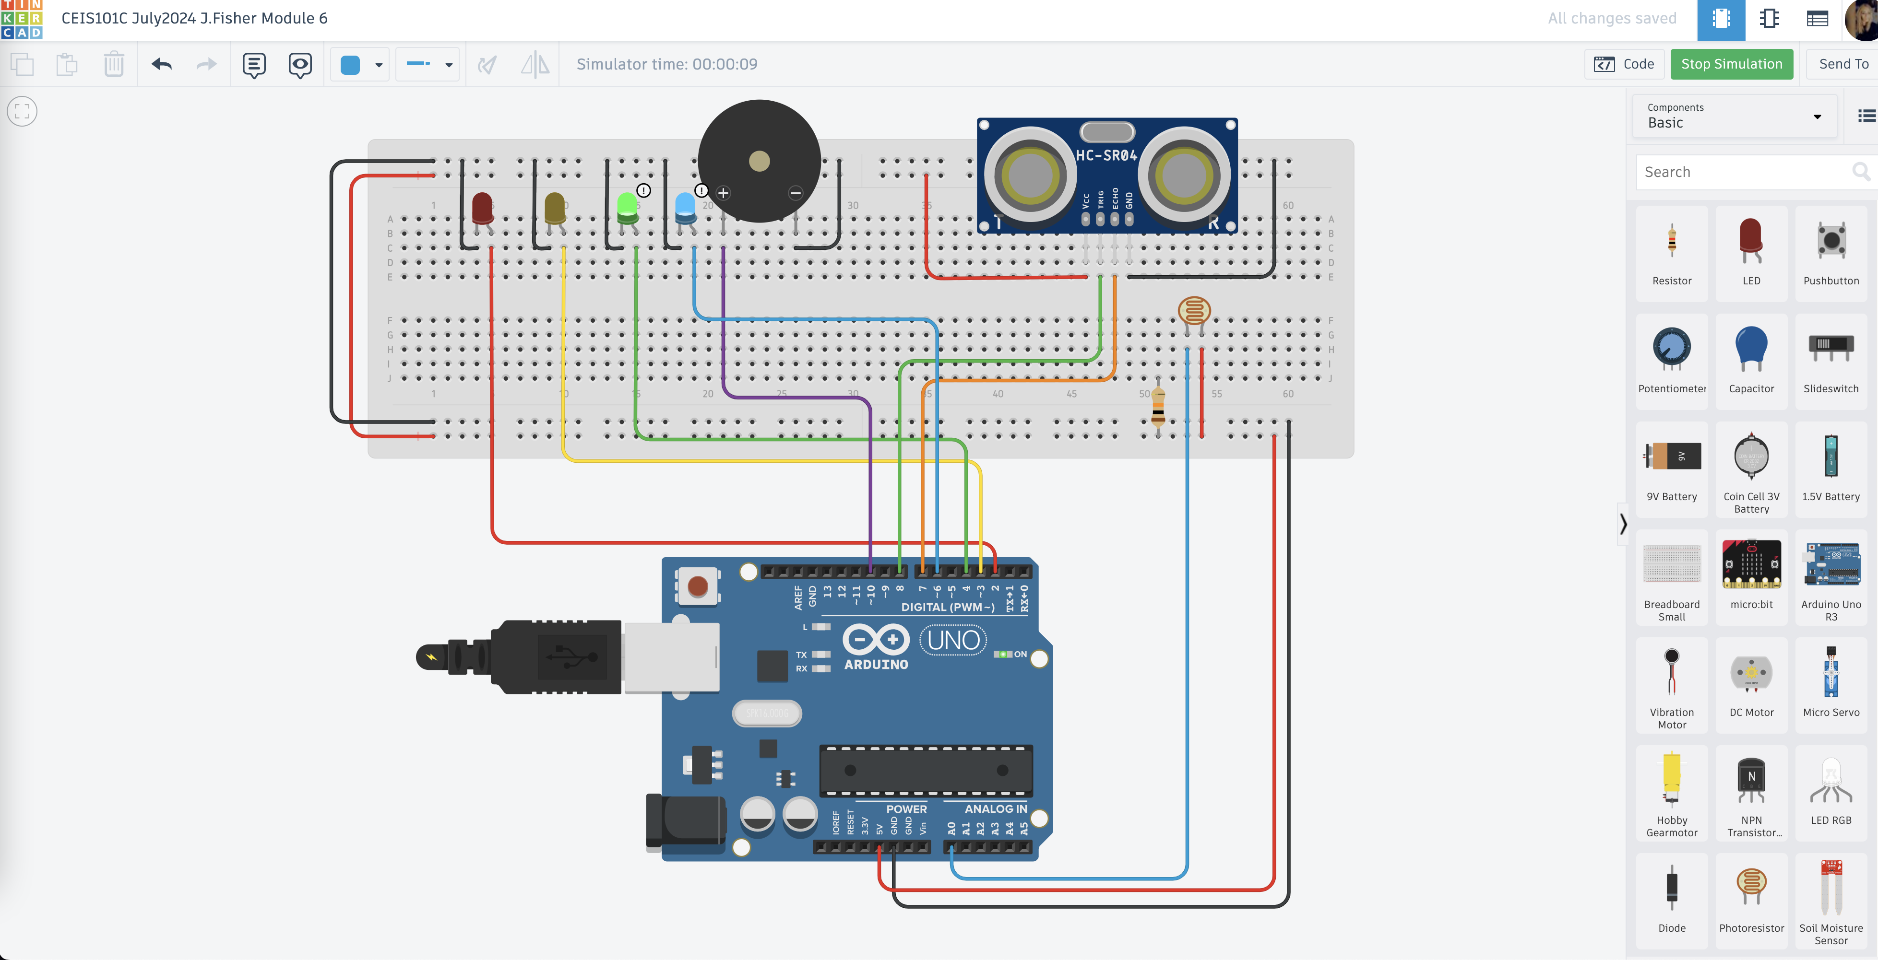
Circuit with automated LED on

Slide 28
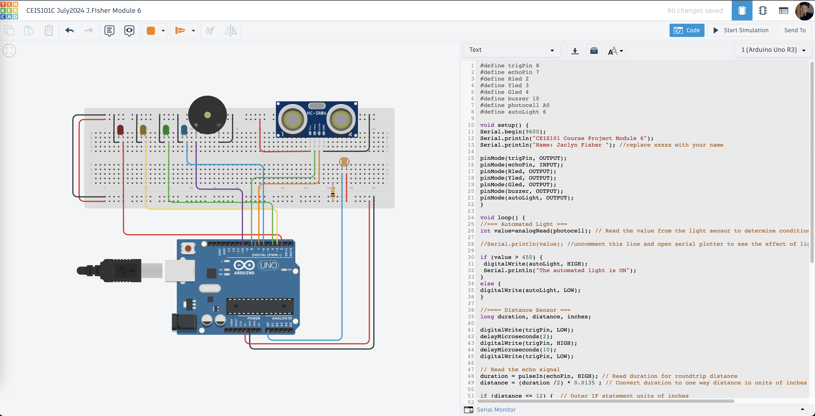
Arduino Code (screenshot)

Slide 29
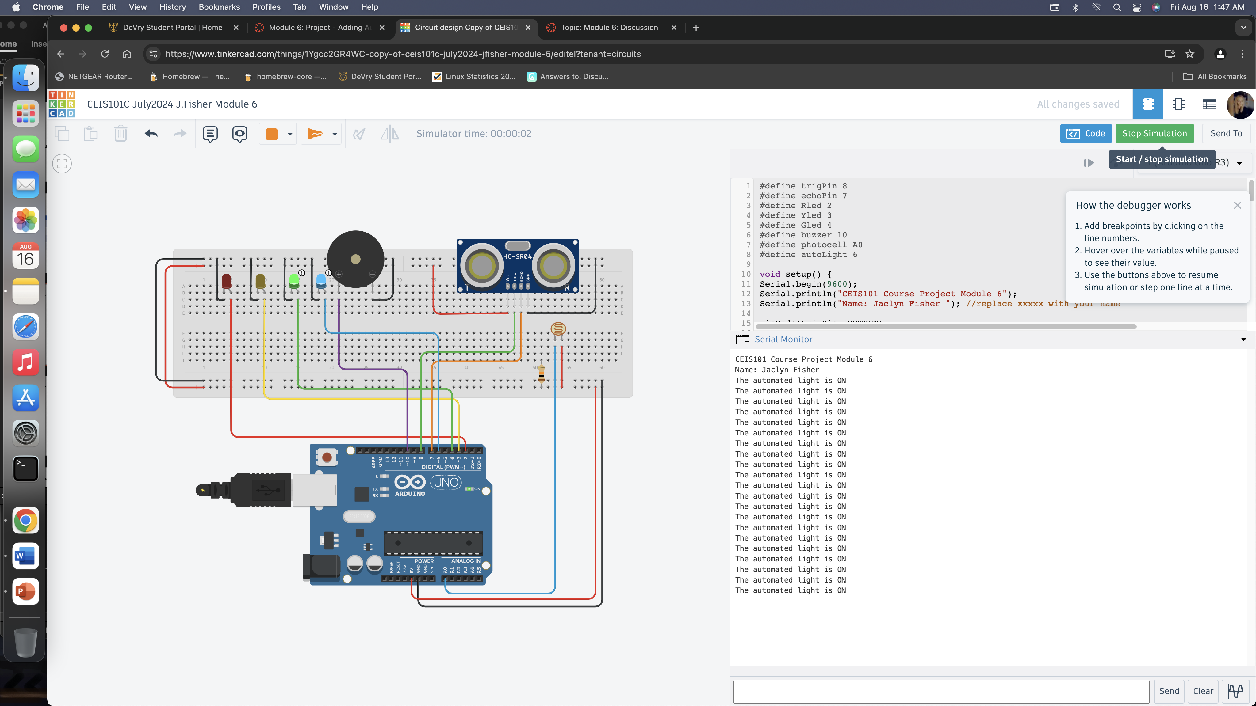
Serial Monitor (screenshot)

Slide 30
Module 6 Objectives
To learn how to connect a light sensor to the Arduino board.
To learn how to write code that uses a light sensor.
Learn how to write code that turns on light based on the reading from the light sensor.

Slide 31
Challenges/Lessons Learned
Being able to familiarize myself with hardware components, see, touch and work with the Arduino, was a challenge as I have never dealt with any kind of circuit boards or virtual emulator/simulators up until this point.
So, I decided to order the Arduino kit from DeVry, and it helped me tremendously. It wasn’t near as difficult as I had originally imagined, and I actually enjoyed it.
I also learned that I had worried for no reason, because in the end, Tinkercad simulator really is just as good as hands on learning.

Slide 32
Career Skills
Hardware design and troubleshooting
understand different networking protocols.
Machine learning and artificial intelligence
Data management
Core competencies to help me gain the opportunities to advance my career include ethical and legal awareness, thinking strategically, adaptability, focusing on results, people skills and communication.

Slide 33
Conclusion
I thoroughly believe that I have made the right choice in pursuing my career in Cybersecurity and networking. I’ve not found myself bored nor have I any type of regrets about this path. Every aspect interests me to the core, and I love problem solving, working out solutions, creativity, helping others, learning and discovery.
I’ve learned quite a bit, and I’m only 8 weeks in! I can’t wait to see what the future holds for me, and this experience has been irrefutably what I needed in my life.

Slide 34
References
For this project, I used Microsoft Word, Microsoft Power Point, Microsoft Excel, the exceptionally well explained videos and help provided and posted by my Professors and Instructors. Below I’ve cited the other sources I used in this project.
https://www.tinkercad.com/dashboard
https://wix.com/
https://www.devry.edu/

