Slide 1


CEIS114
Course project traffic controller
Name: Jaclyn Fisher
Professor: Ming Qian
Session: September 2024
Date: 10/22/2024

Slide 2

Introduction
I performed this project using Wokwi, an online electronics simulator in which I have created and programmed a multi-intersection traffic light controller with a pedestrian crossing and an emergency signal. This secured system can be controlled remotely via a web browser and has an integrated SMART Sensor to trigger signal changes based on traffic flow.

Slide 3
CEIS114 Module 2 Starting Wokwi virtual simulator, setting up the ESP32 microcontroller, and adding components.

Slide 4
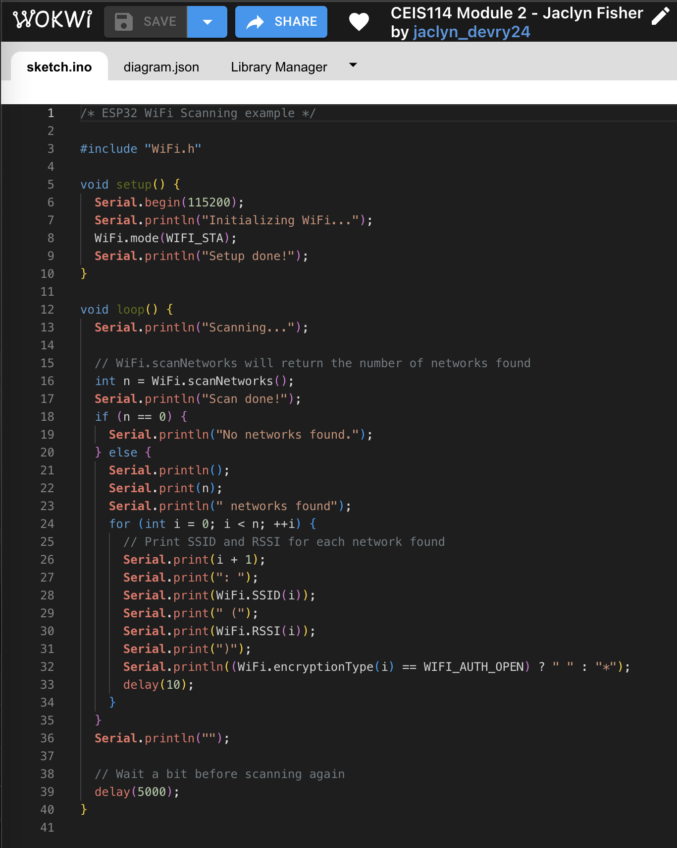
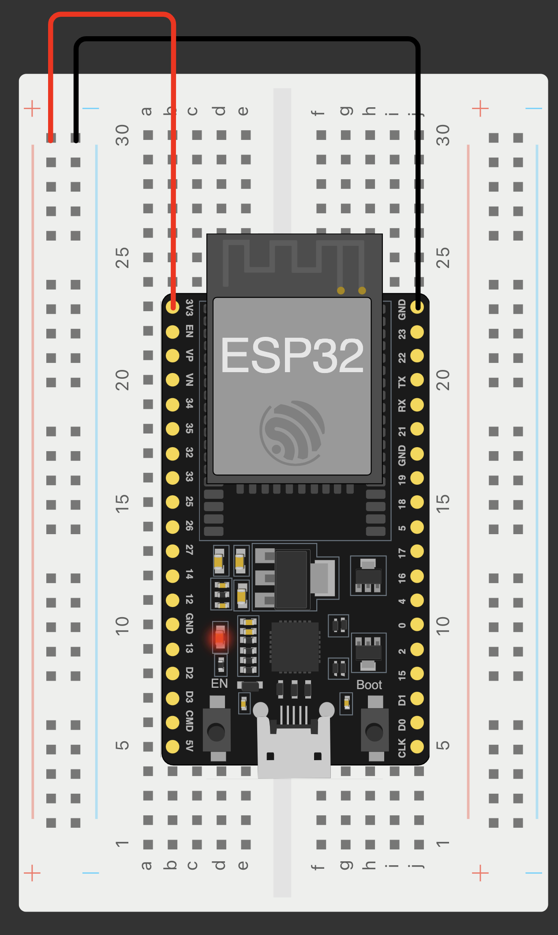
CEIS114 Module 2
  Screenshot of ESP32 microcontroller mounted and powered on using
  wifi-scan.ino code.

Slide 5
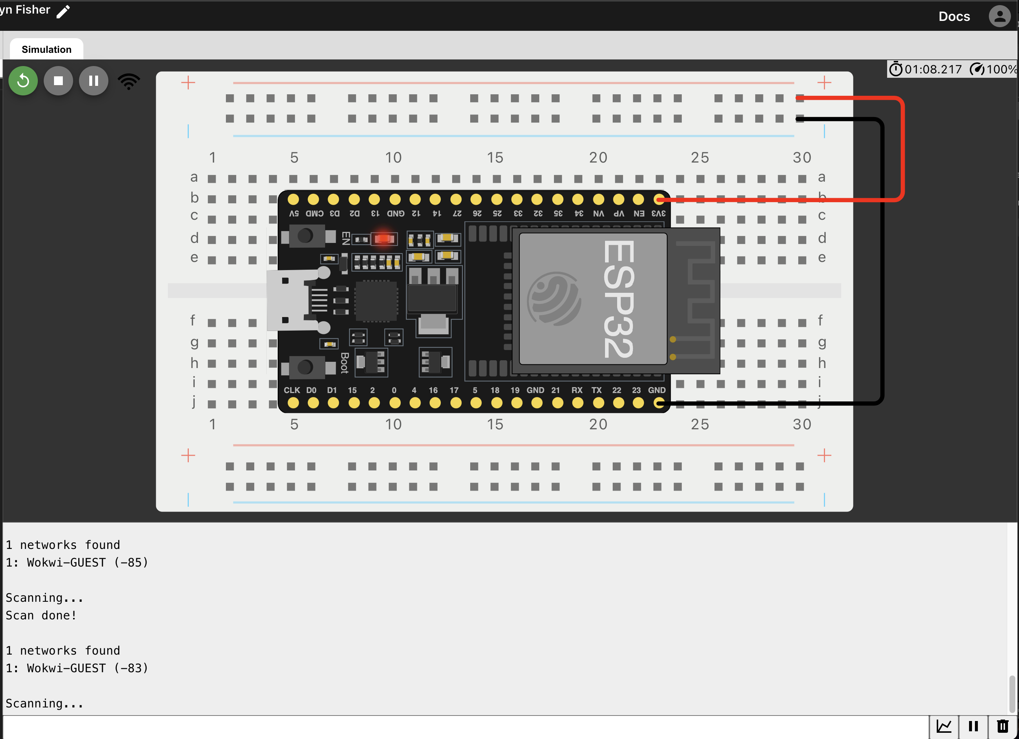
Module 2 - ESP32 Wi-Fi Scan
Screenshot of Serial Monitor showing the available networks

Slide 6
CEIS114 Module 3
Create a single traffic controller using Wokwi. Execute a program using code to simulate a single traffic light by gaining control of the 3 LED lights.

Slide 7
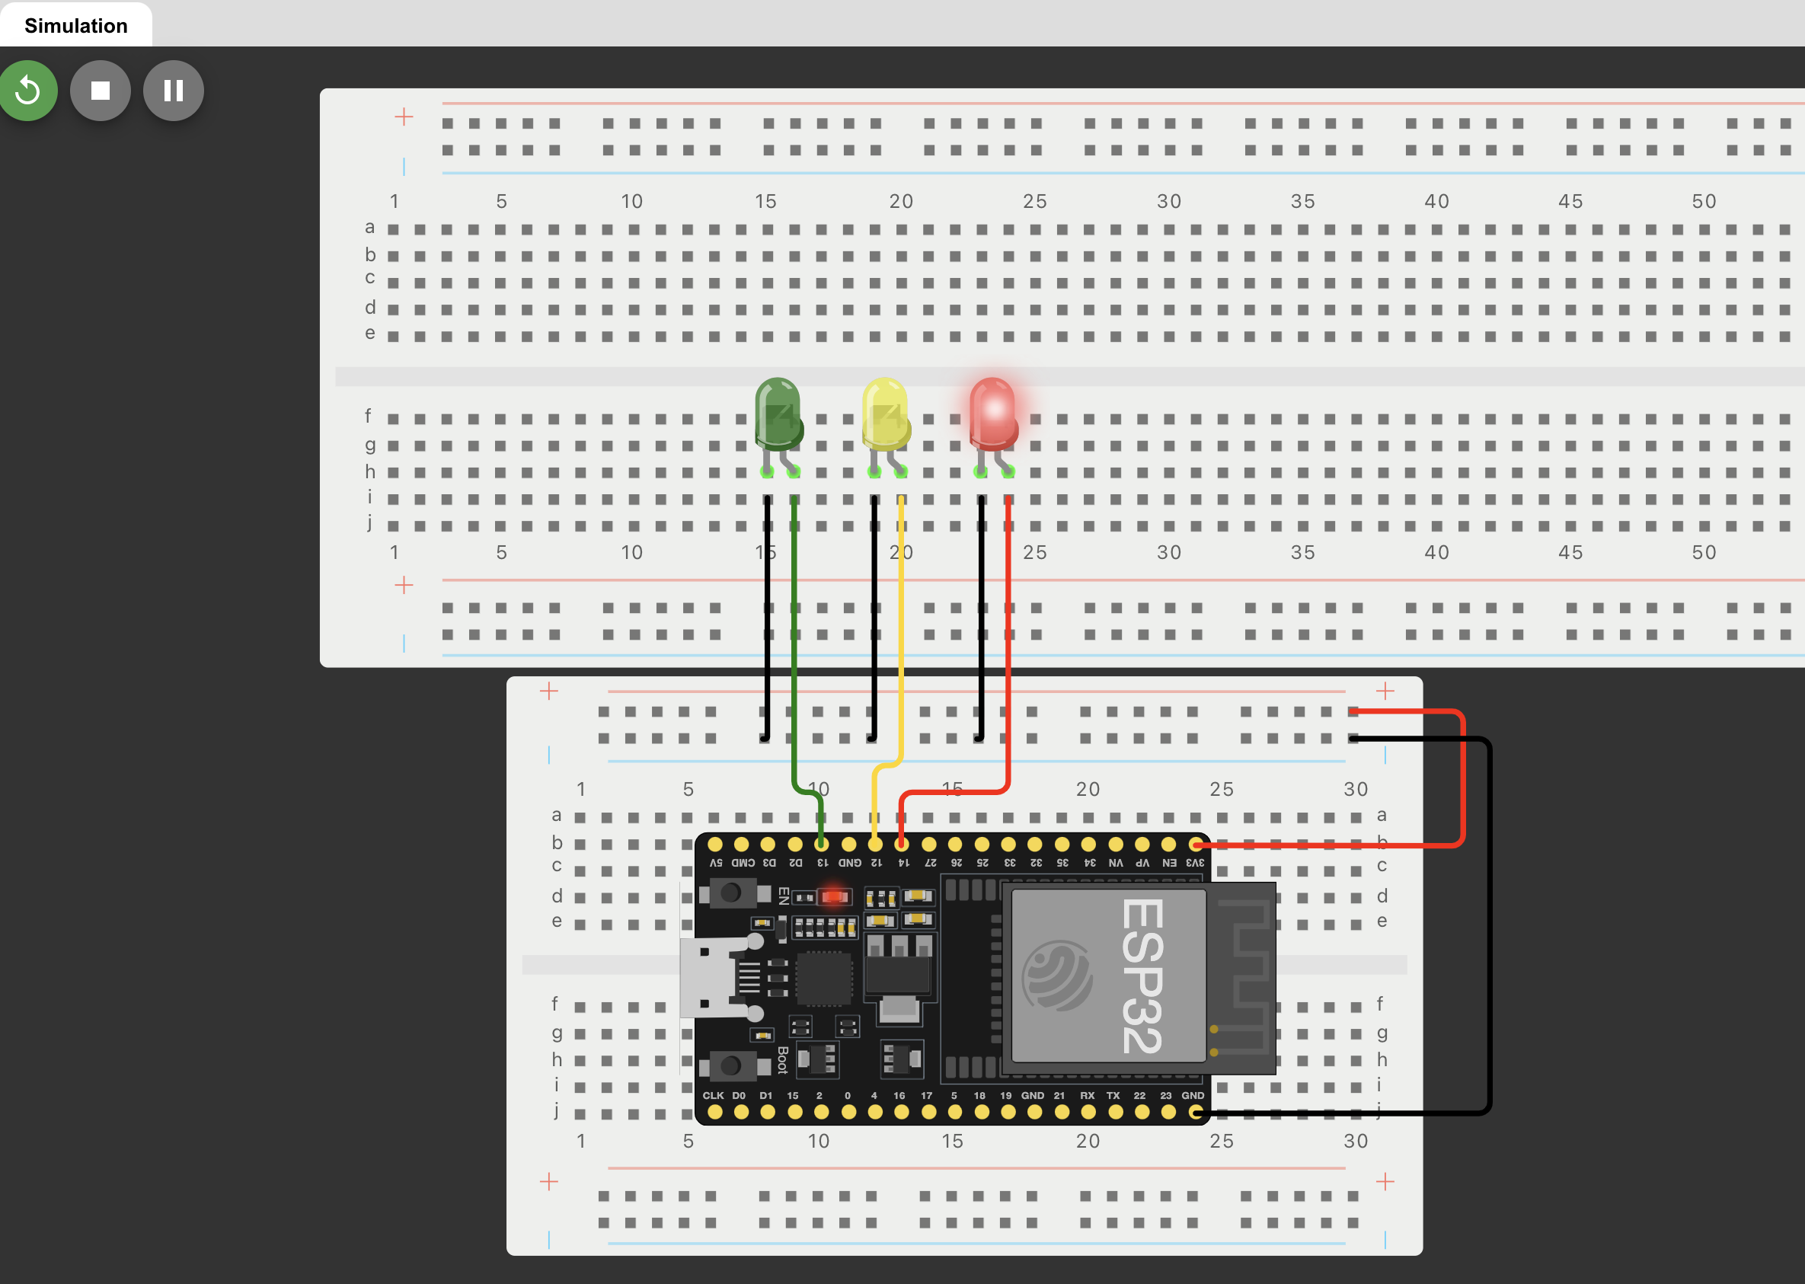
CEIS114 Module 3
  Screenshot of circuit with working LEDs
ESP32 board
Colored LEDs: Yellow, red, and green
2 Breadboards
Power and ground Wires

Slide 8
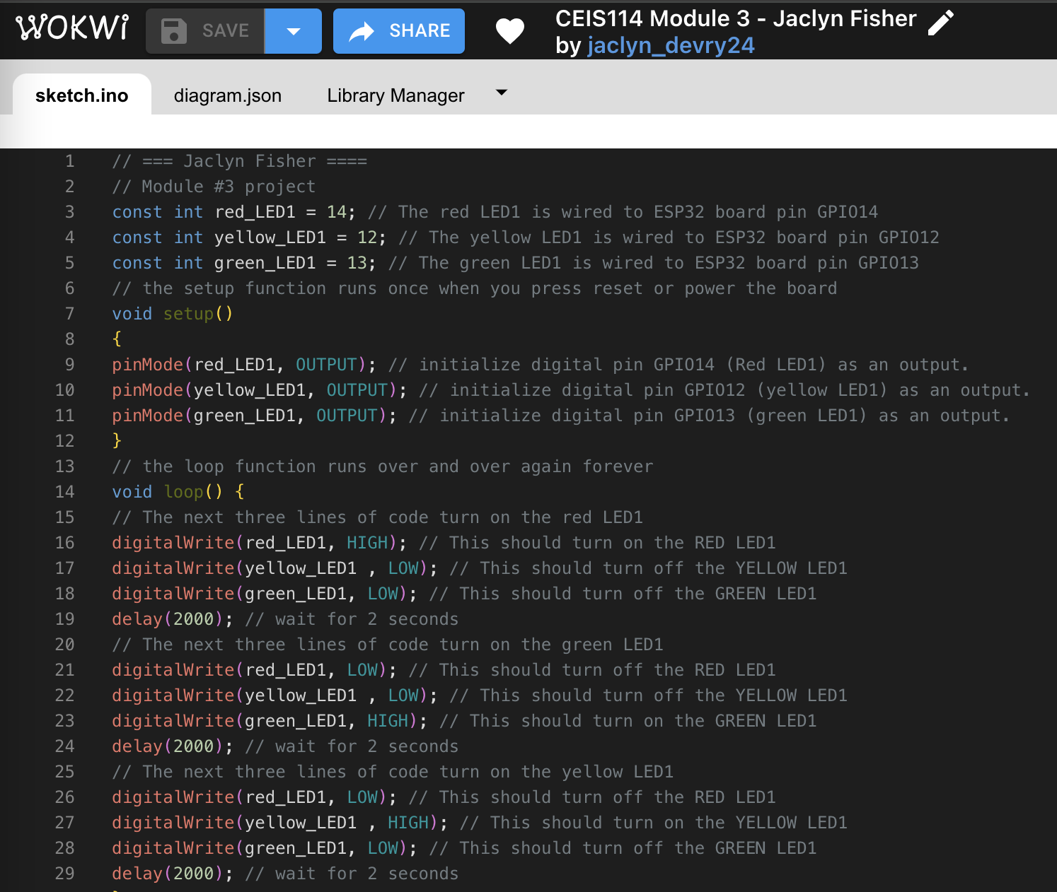
CEIS114
Module 3
Screenshot of code in the Wokwi Code Editor showing my name in the top comment.

Slide 9
CEIS114 Module 4
Creating a Multiple Traffic Light Controller
Adding a second set of Red, Green, and Yellow LEDs to the ESP32 microcontroller in Wokwi virtual environment.
.

Slide 10
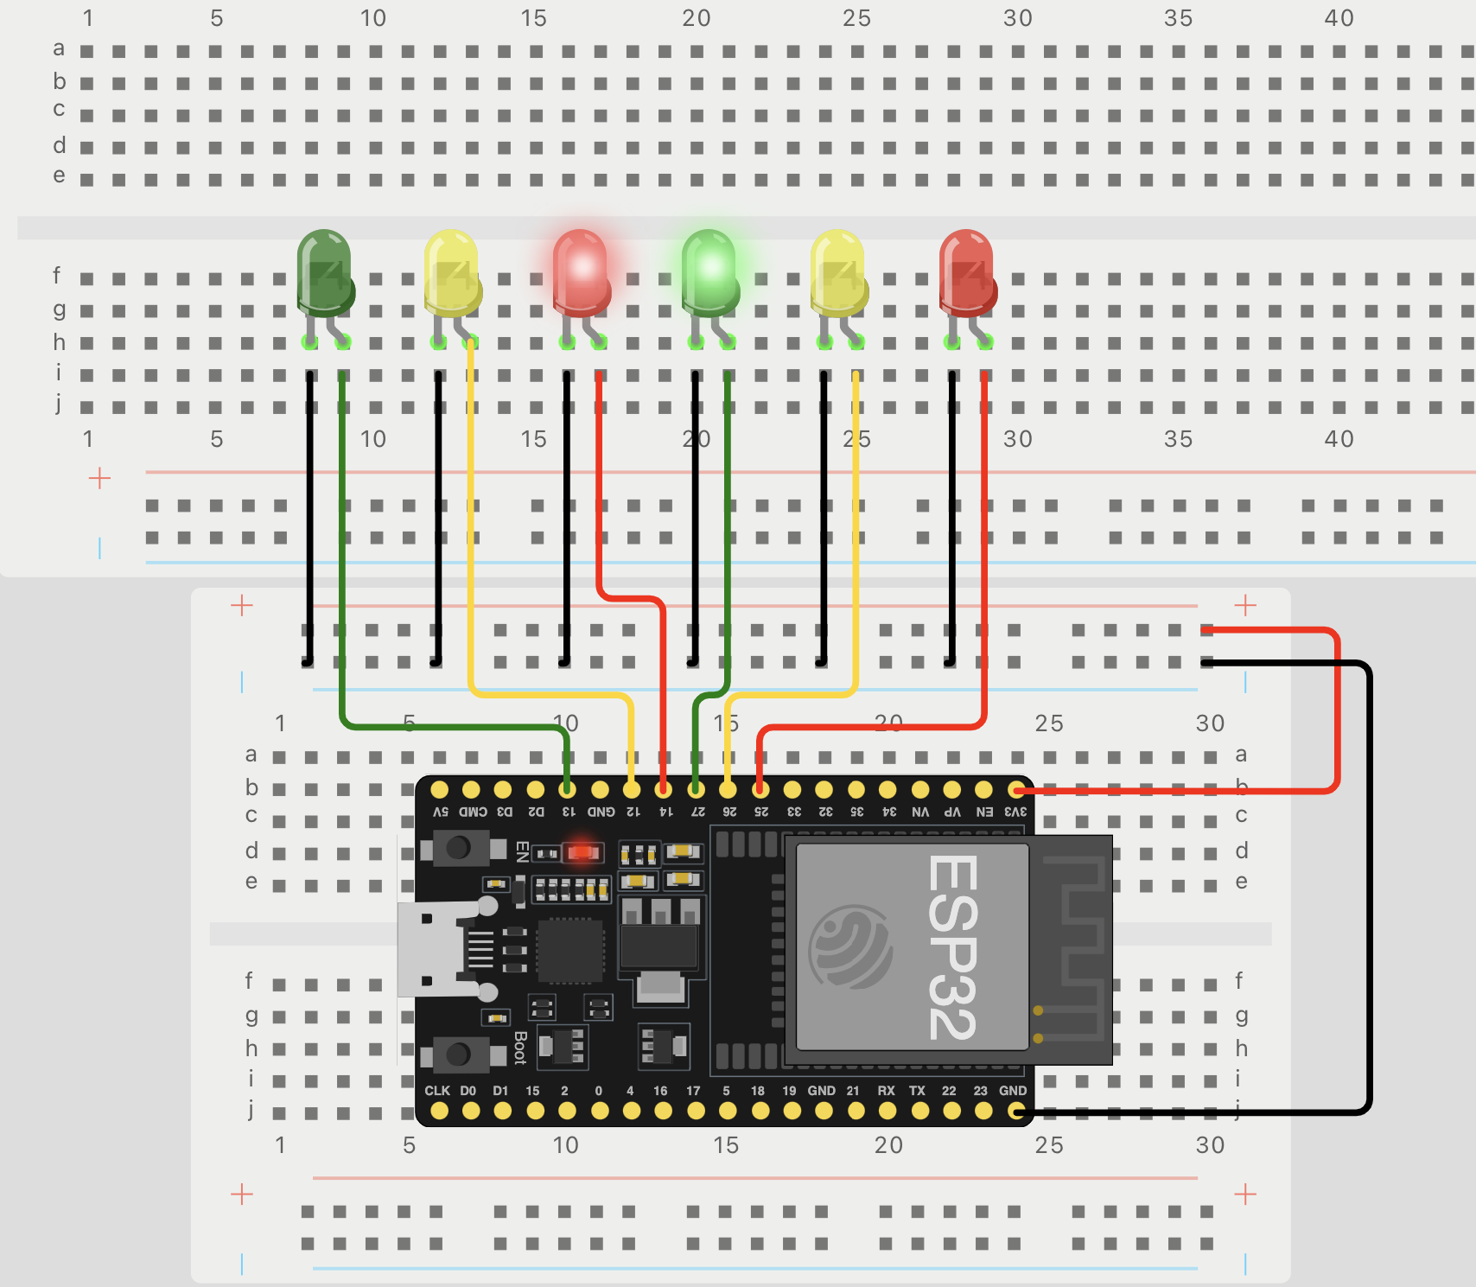
CEIS114
Module 4
Picture of circuit
with working LEDs
ESP32 Board in Wokwi
Second set of colored LEDs:
Red, Yellow and Green (two sets)
2 Breadboards
Power and ground Wires

Slide 11
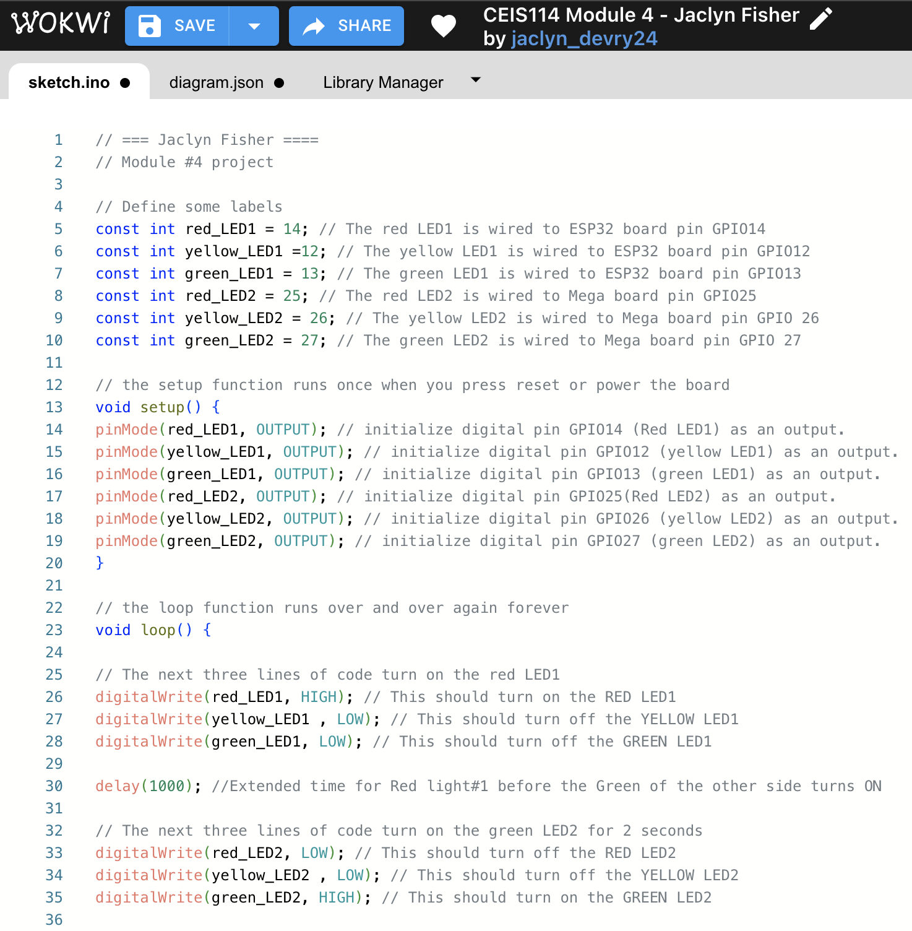
CEIS114
Module 4
Screenshot of code in the Wokwi Code Editor showing my name in the top comment.

Slide 12
CEIS114 Module 5
Multiple Traffic Light Controller with Cross Walk
Adding a cross walk and utilizing a Push Button in Wokwi virtual environment.

Slide 13
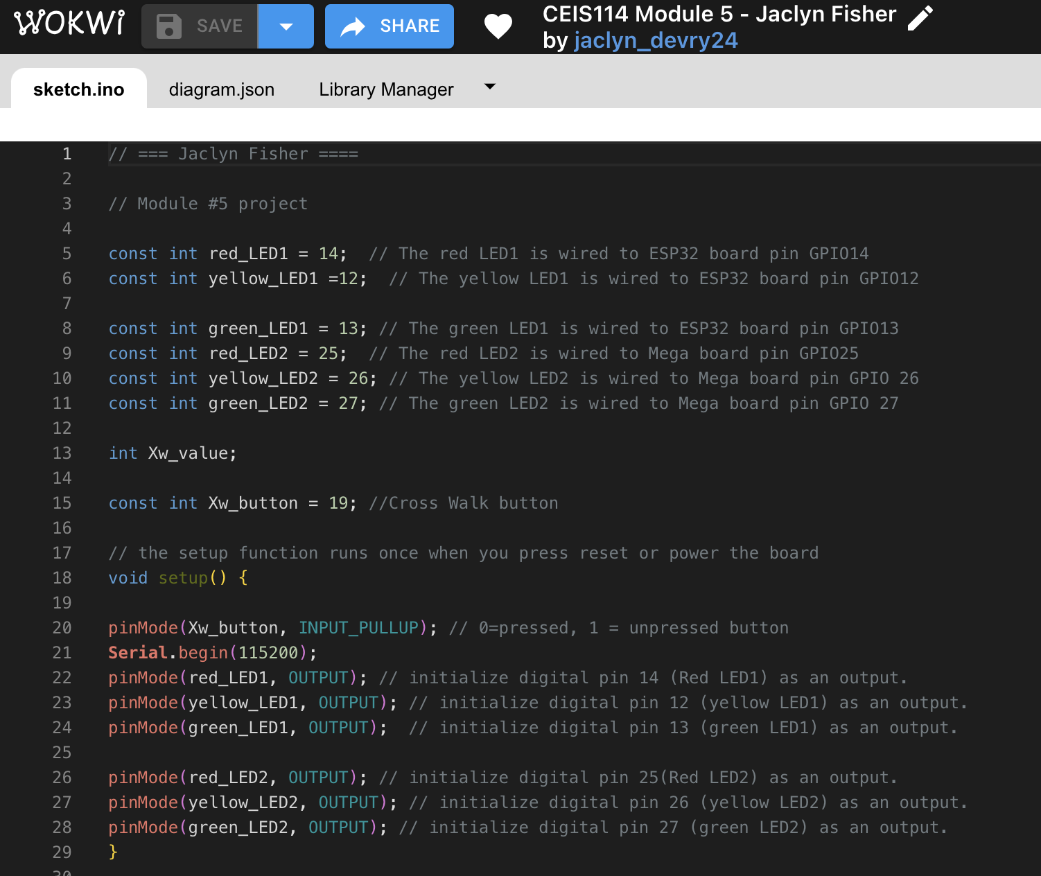
CEIS114
Module 5
Screenshot of code in Wokwi Code Editor

Slide 14
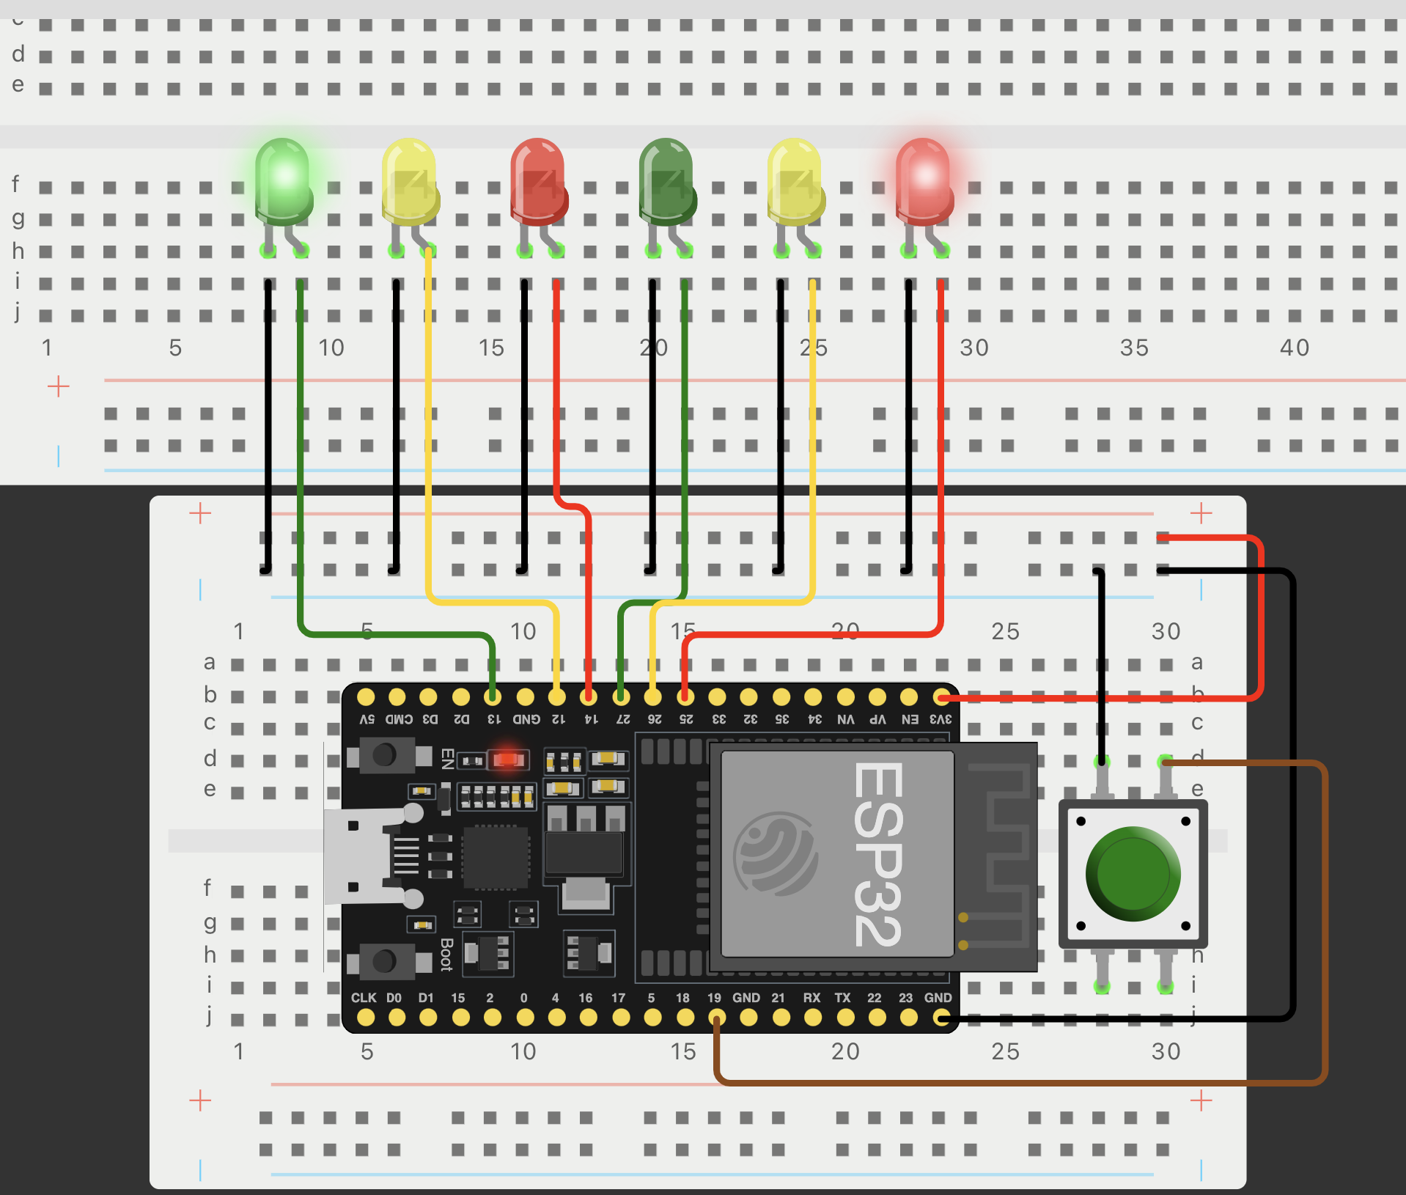
CEIS114
Module 5
Screenshot of circuit with working LEDs
ESP32 Board in Wokwi
2 Breadboards
Push Button
Power and ground Wires
Colored LEDs: Red, Yellow and Green (two sets)

Slide 15
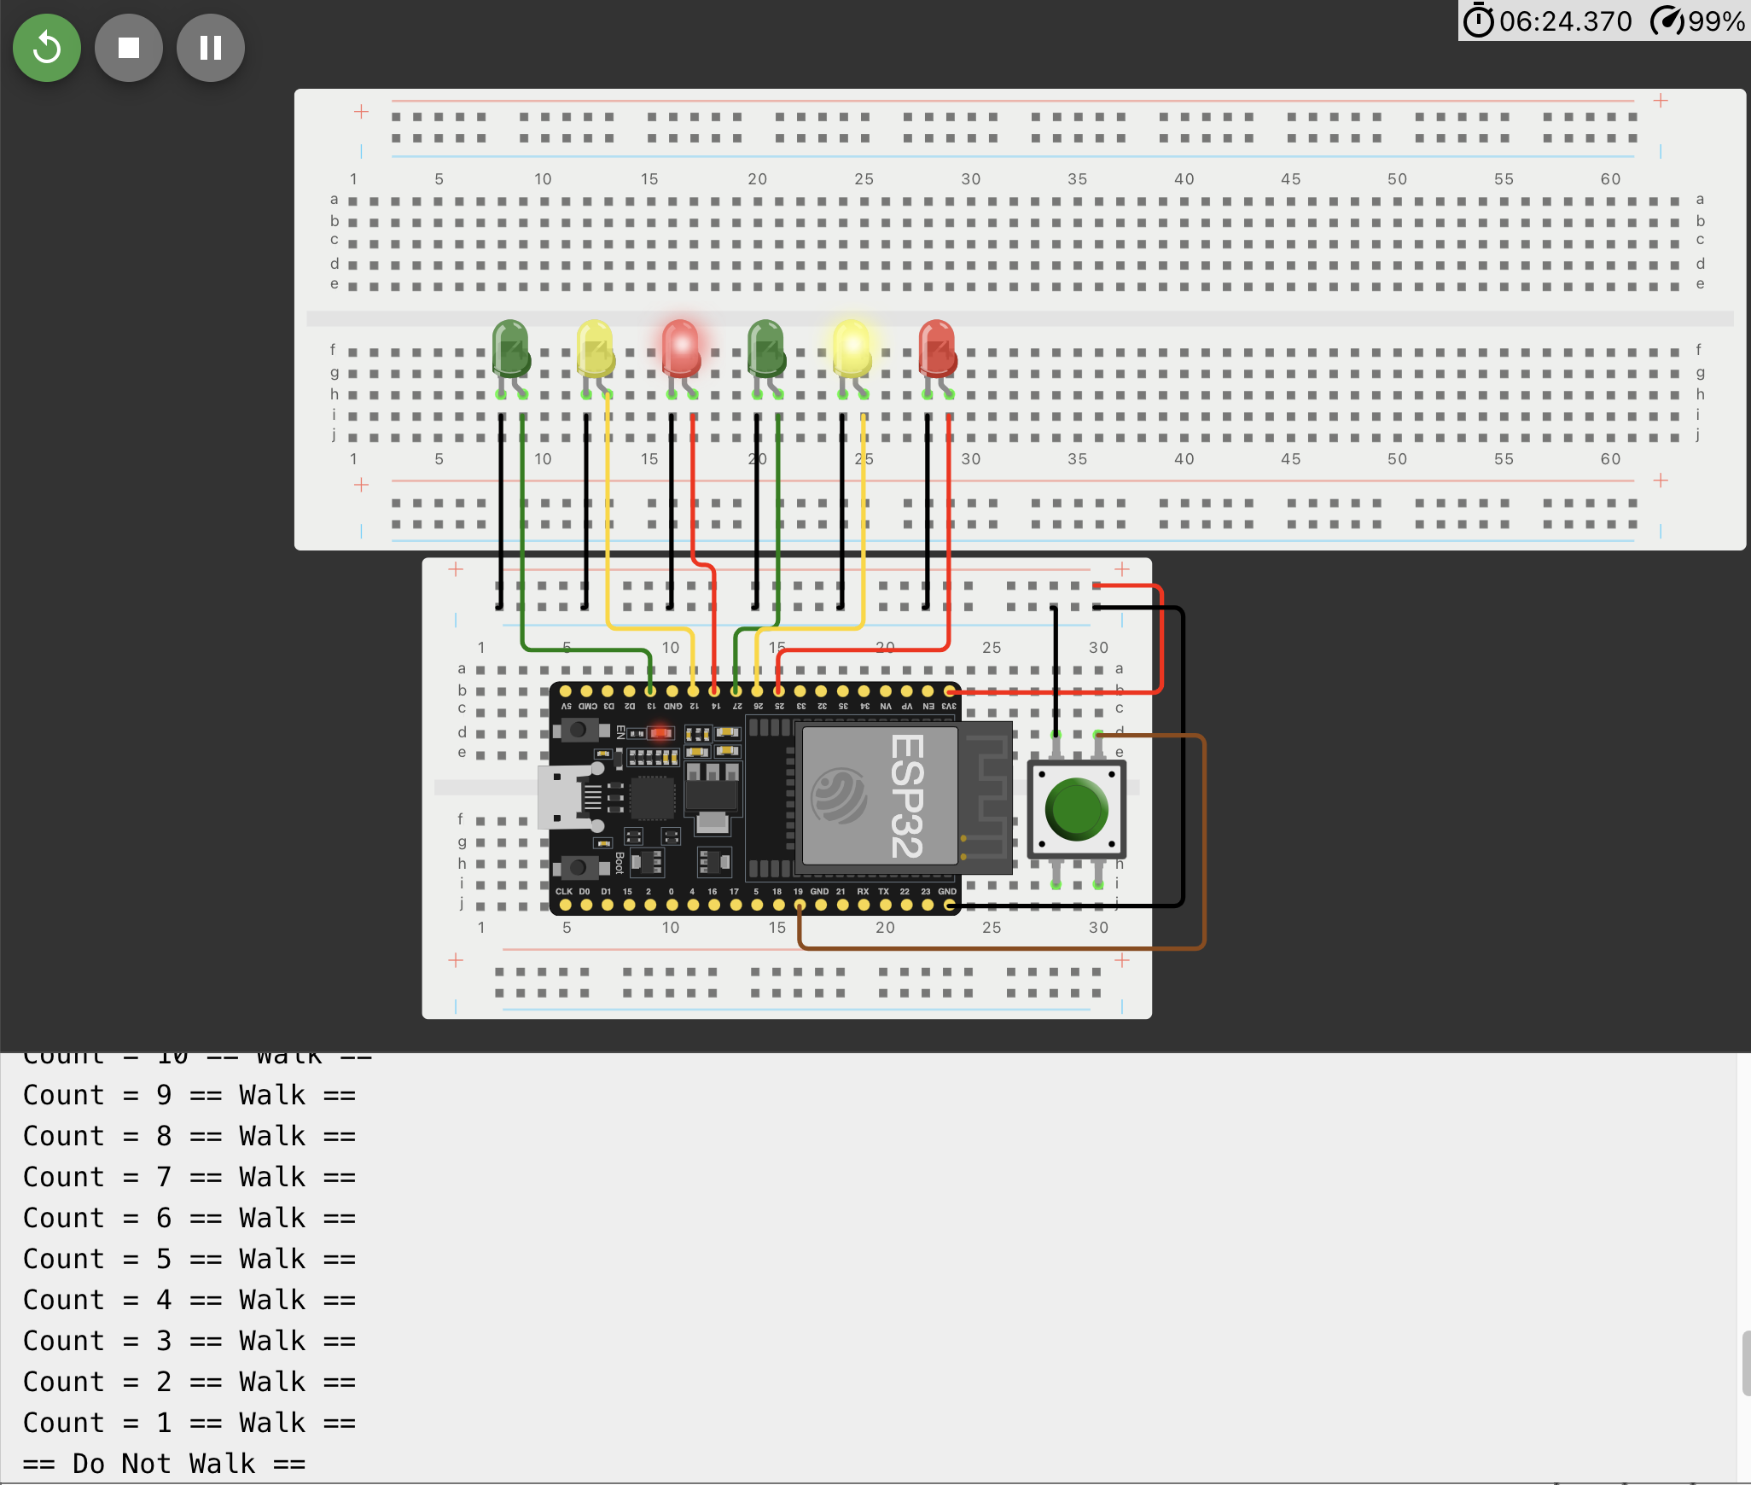
CEIS114
Module 5
Screenshot of Serial Monitor and crosswalk output in Wokwi’s Virtual Simulator.

Slide 16
CEIS114 Module 6
Multiple Traffic Light Controller with Cross Walk, Buzzer, and LCD Display
adding a buzzer and an LCD panel in Wokwi virtual environment.

Slide 17
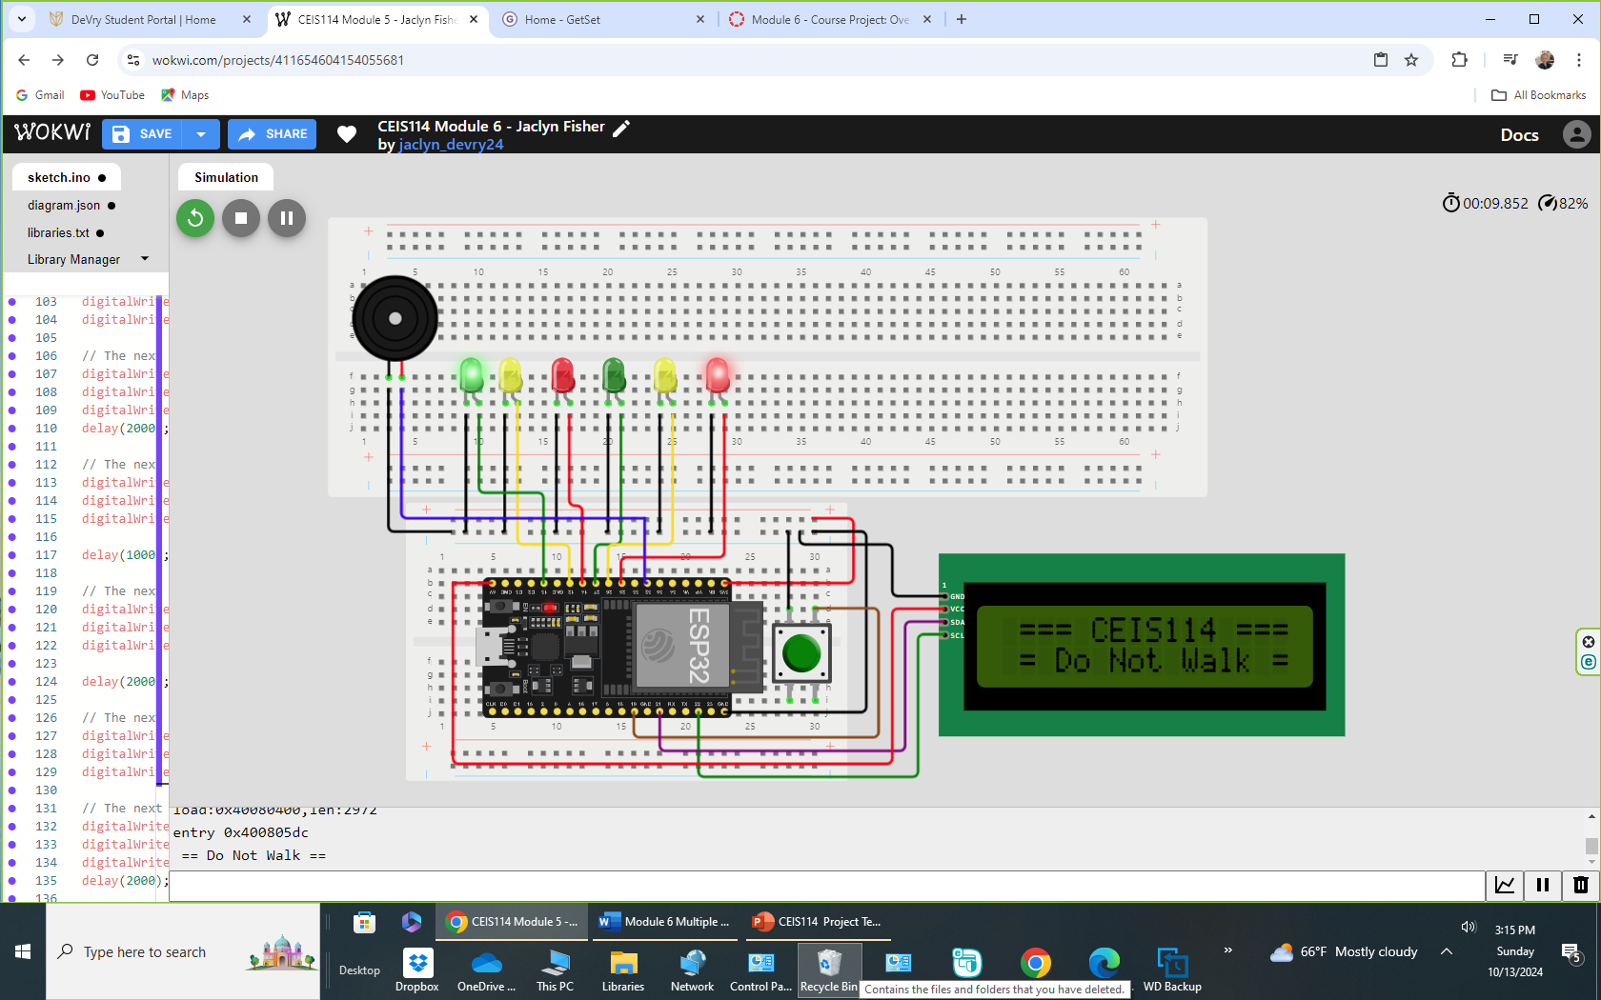
CEIS114
Module 6
Picture of circuit with working LEDs and LCD display.
ESP32 Board
Colored LEDs: Red, Yellow and Green (two sets)
Buzzer
Push Button
LCD Unit with Message Display
Wires
Breadboard

Slide 18
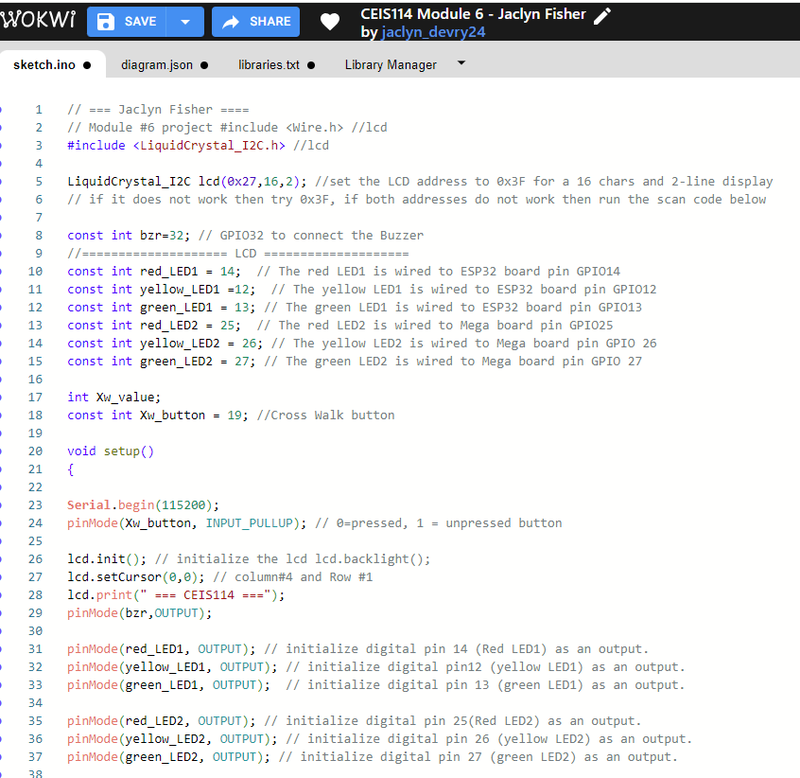
CEIS 114 Module 6
Screenshot of code in Wokwi Code Editor.

Slide 19
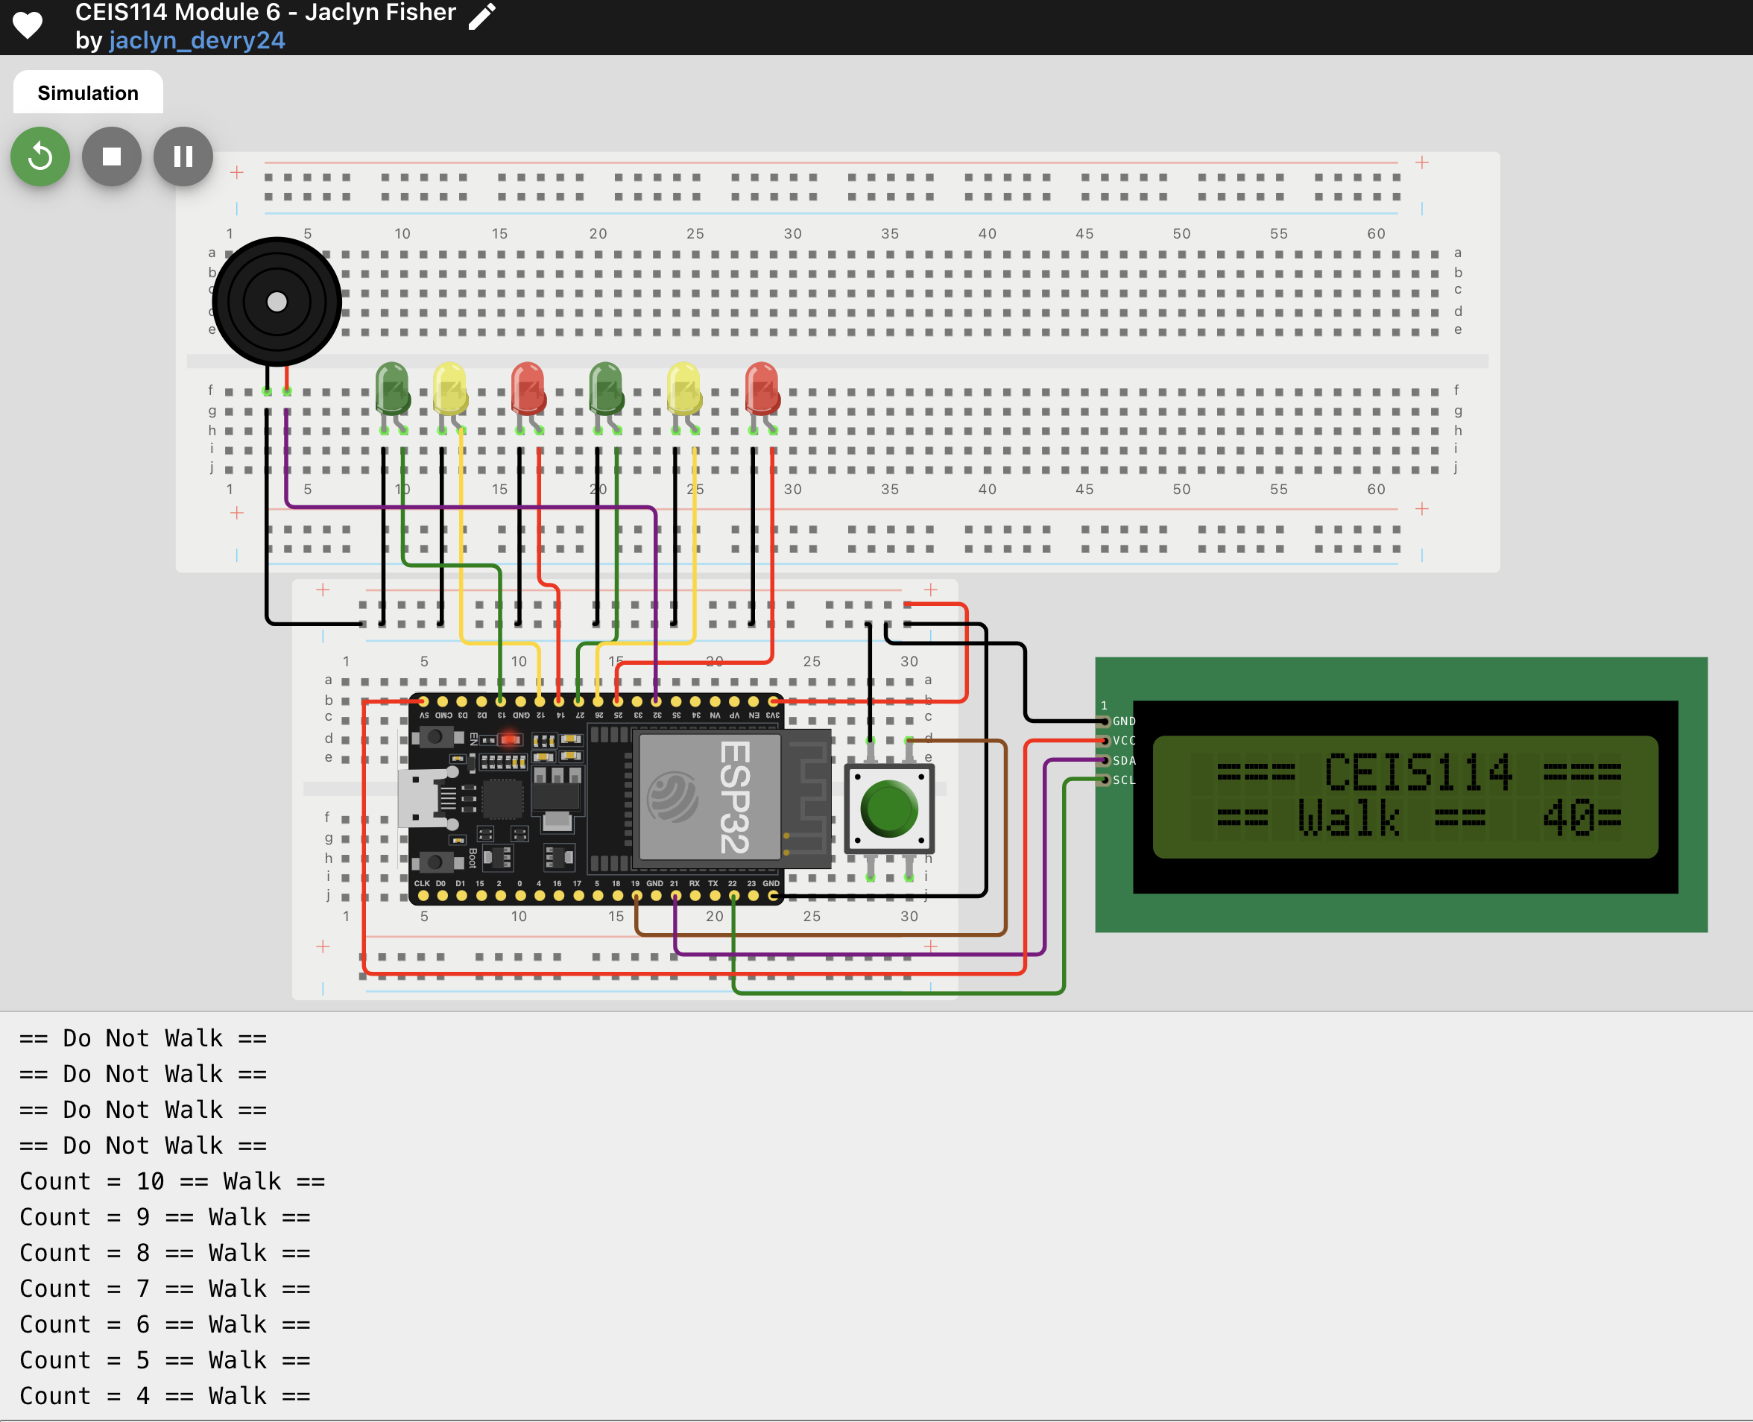
CEIS114
Module 6
Screenshot of Serial Monitor and output in Wokwi’s Virtual Simulator.

Slide 20
CEIS114 Module 7
Multiple Traffic Light Controller with Cross Walk, Buzzer, and LCD Display with IOT Access.

Slide 21
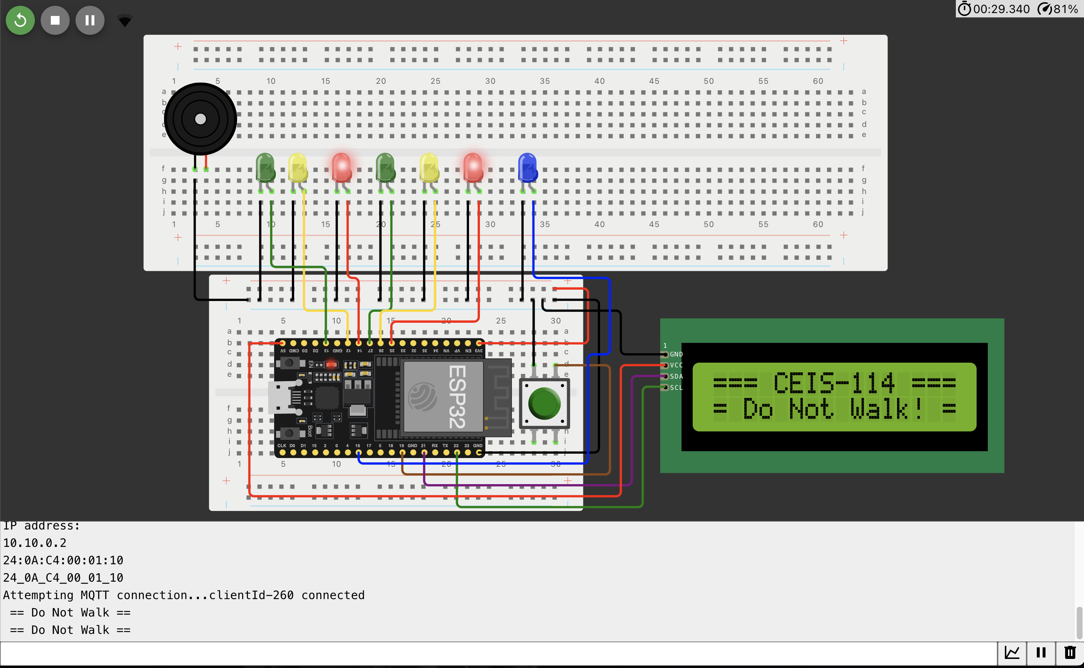
CEIS 114
Screenshot of circuit with working LEDs and LCD display (Building/Operation)
ESP 32 Board
Colored LEDs: Red, Yellow and Green (two sets)
One Blue LED – Emergency Light
Push Button
Breadboard
LCD Unit
Buzzer
Power & ground wire

Slide 22
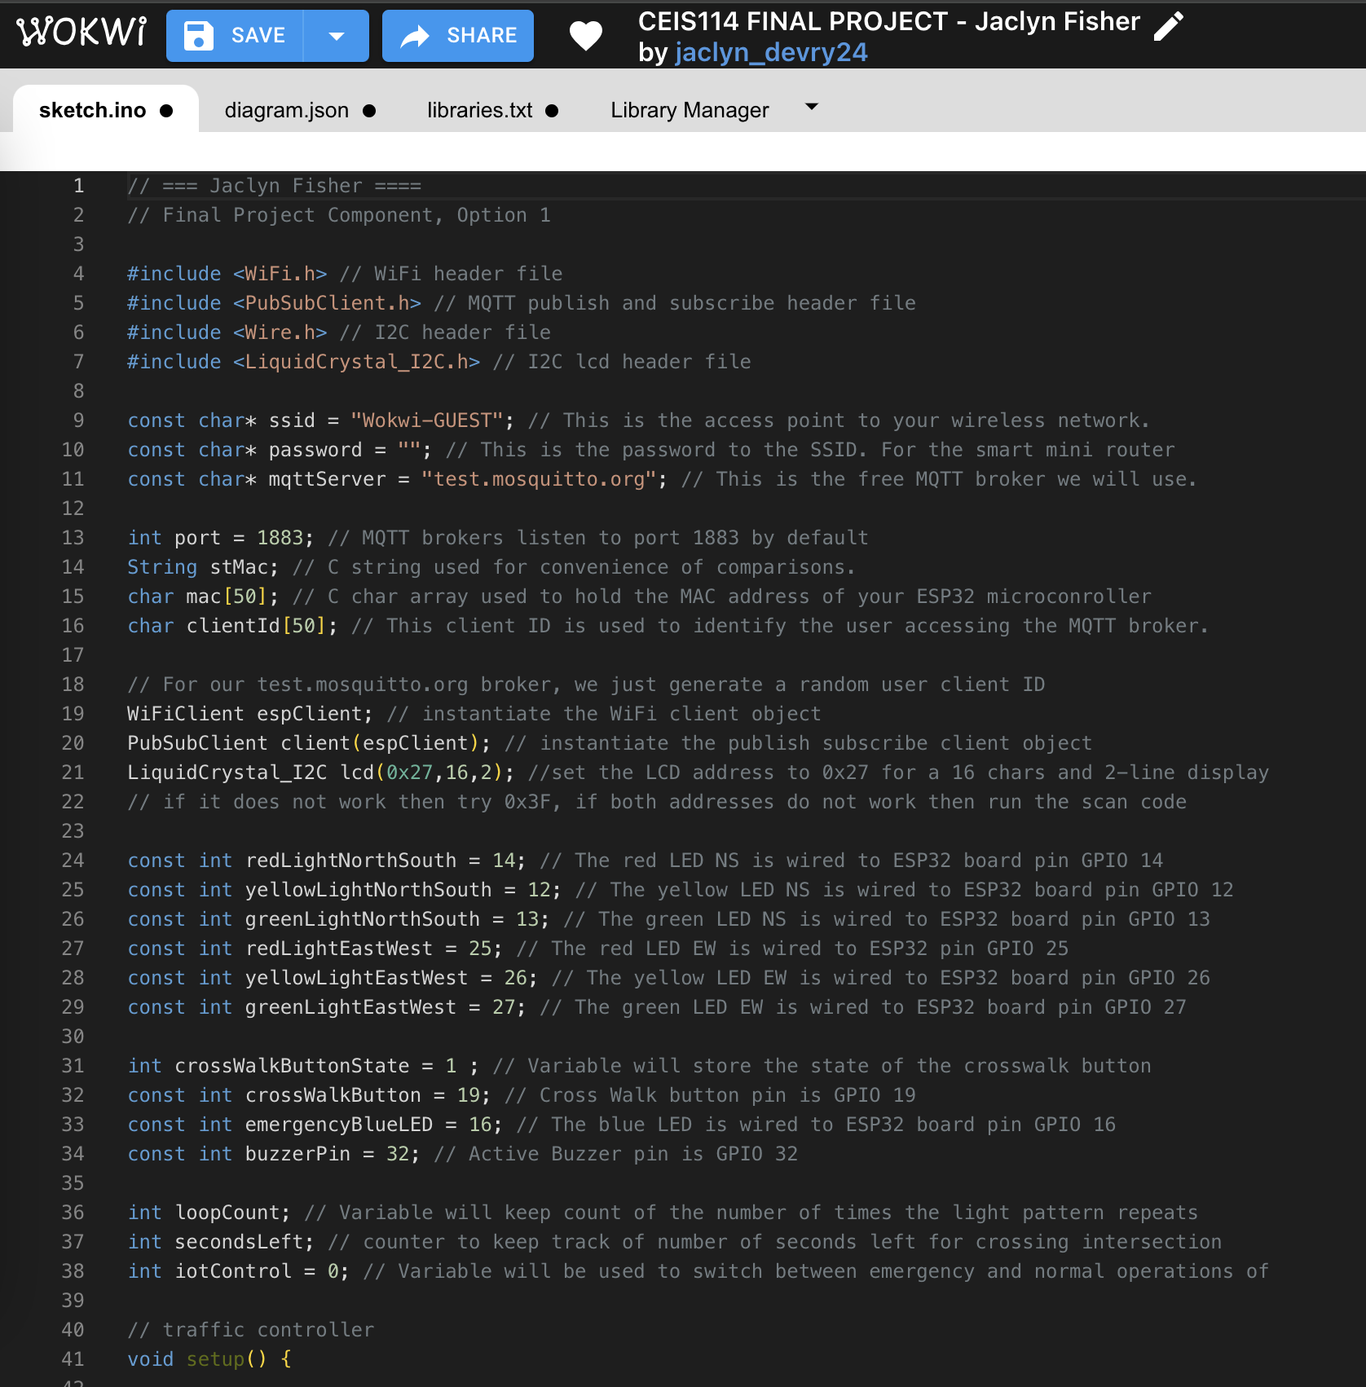
CEIS114
Final Project
Screenshot of code in Wokwi Code Editor

Slide 23
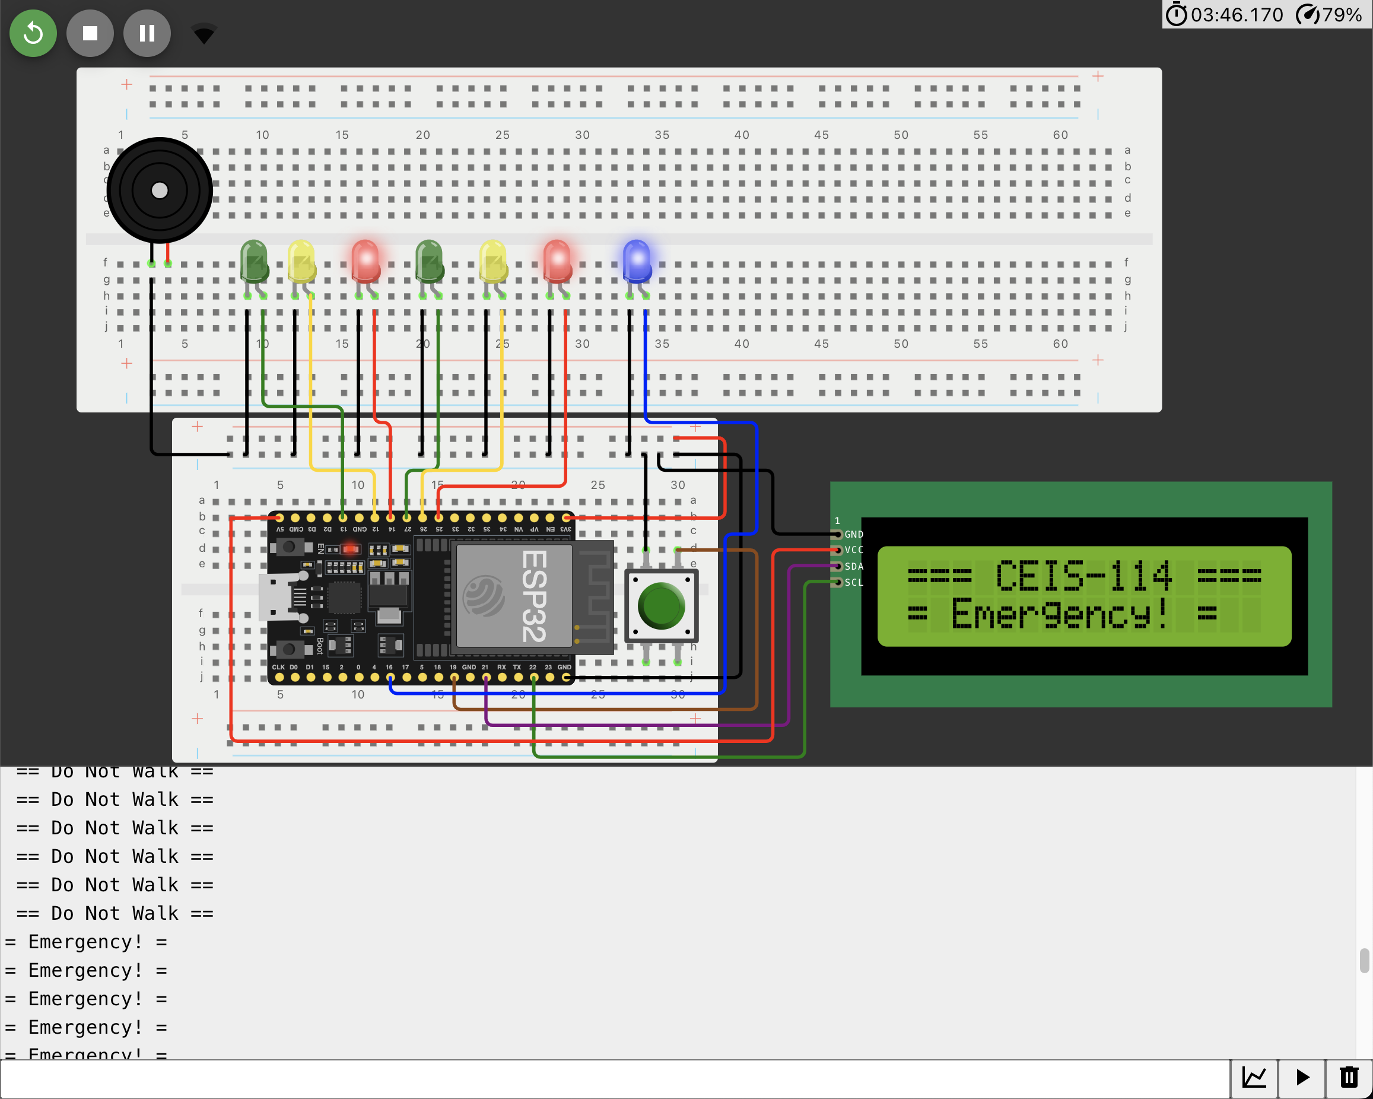
CEIS 114
Final Project
Screenshot of Serial Monitor (Testing)
Screenshot of output in Serial Monitor

Slide 24
Challenges
Being able to familiarize myself with hardware components, see, touch and work with a circuit board or microcontroller, was a challenge as I have never worked with any kind of circuit boards or virtual emulator/simulators up until this point.
But Wokwi was great and made it an extremely easy to learn and understand through their virtual emulator.

Slide 25
Career Skills
Networking & Connectivity Ability
Coding/Programming
Security Awareness
Automation
Operating System Fundamentals
Understanding of the IoT
Hardware & Device Knowledge

Slide 26
Conclusion
I thoroughly believe that I have made the right choice in pursuing my career in Cybersecurity and networking. I’ve not found myself bored nor have I any type of regrets about this path. Every aspect interests me to the core, and I love problem solving, working out solutions, creativity, helping others, learning and discovery.

Slide 27



References
For this project, I used Microsoft Word, Microsoft Power Point, Microsoft Excel, the exceptionally well explained videos and help provided and posted by my Professors and Instructors. Below I’ve cited the other sources I used in this project.
https://wix.com/
https://www.devry.edu/
https://wokwi.com/

