Slide 1
Physics In Action:
A Sensor-based Exploration Of Motion, Energy, And Magnetism
Jaclyn Fisher
DeVry University
08/2025

Slide 2


Introduction
Physics helps explain how the world works through the study of motion, energy, and electromagnetism.
In this course project, I applied these concepts using ultrasonic and rotary sensors along with an ESP32 microcontroller.
The goal is to test theories through experiments, analyze data, and show how sensor technology makes physics measurable and practical.
This presentation walks through five key experiments, following the scientific method from motivation to conclusions.

Slide 3

Inventory of parts and software
Introduces the hardware and software tools used throughout the projects.
Highlights the role of sensors and programs in collecting and analyzing data.
Establishes the foundation needed to understand later experiments and results.

Slide 4
Ultrasonic Sensor HC-SR04
The HC-SR04 ultrasonic sensor measures distance using high-frequency sound waves. It emits a short burst of sound, then detects the echo when it bounces off an object. By calculating the travel time of the echo and dividing by two, the sensor determines distance. This principle makes the HC-SR04 useful for motion and free-fall experiments later in the course.

Slide 5
Rotary Encoder KY-040
The KY-040 rotary encoder converts rotary motion into electrical signals. Each twist of the knob generates pulses that can be decoded by a microcontroller to measure rotation and direction. This sensor provides the data needed for analyzing circular motion in later labs.

Slide 6
Hall Effect Sensor in ESP32
The Hall effect sensor inside the ESP32 detects magnetic fields. When exposed to a magnetic field, it produces a voltage based on the field’s strength and polarity. This principle allowed us to measure electromagnetic effects during the final module experiments.

Slide 7
Rotary Encoder KY-040
The KY-040 rotary encoder converts rotary motion into electrical signals. Each twist of the knob generates pulses that can be decoded by a microcontroller to measure rotation and direction. This sensor provides the data needed for analyzing circular motion in later labs.

Slide 8

Screenshots
To document software tools, screenshots were taken using the built-in Screenshot utility on a Mac. This ensured proof of software installation and readiness for data collection and analysis.

Slide 9

Required
Software
Microsoft Excel installed and running, used for organizing raw data, building graphs, and performing calculations.

Slide 10
Overview
Documented sensors and tools used throughout the course: HC-SR04 ultrasonic sensor, KY-040 rotary encoder, and ESP32 Hall effect sensor.
Verified setup and software readiness through screenshots.
Used Microsoft Excel for organizing data, generating graphs, and running calculations.
Established a reliable foundation for accurate project work.

Slide 11
Precision of the Ultrasonic Sensor
Evaluated the precision of the ultrasonic sensor in measuring distance and velocity.
Highlighted the importance of sensor accuracy for reliable physics experiments.
Compared measured velocities against the accepted speed of sound (343 m/s).

Slide 12
Data Collection
Trial | Ruler Distance (cm) | Total Roundtrip Distance (m) | Time from Serial Monitor (microseconds) | Roundtrip time (s) | Velocity = distance/time (m/s)
1 | 8 | 0.16 | 492 | 0.000492 | 325.20
2 | 10 | 0.20 | 586 | 0.000586 | 341.30
3 | 15 | 0.30 | 925 | 0.000925 | 324.32
4 | 20 | 0.40 | 1187 | 0.001187 | 336.98
5 | 30 | 0.60 | 1724 | 0.001724 | 348.03
Multiple trials were performed at different distances. The ruler provided actual distances, while the ultrasonic sensor measured the roundtrip travel time of sound waves. These values were converted into velocity for analysis.

Slide 13



Data Analysis
Average velocity from table
Percent difference where $v_{sound}=343 m/s$
$$v_{avg}= \frac{v_{1}+v_{2}+v_{3}+v_{4}+v_{5}}{5}$$
Answer: 335.1672 m/s
$$Percent difference = \frac{\left|v_{avg}−v_{sound}\right|}{v_{sound}}×100$$
Answer: 2.28. %

Slide 14
Overview
The ultrasonic sensor measured an average velocity of 335.17 m/s, compared to the accepted 343 m/s.
The 2.28% difference confirms the sensor’s strong accuracy.
Slight variations were likely due to environmental factors (temperature, humidity, or timing).
Overall, the ultrasonic sensor demonstrated high precision, validating its use for future experiments.

Slide 15
Gravitational Acceleration of a Free-Falling Object
Investigated gravitational acceleration through direct measurement of free-fall motion.
Analyzed how potential energy converts into motion under gravity.
Compared experimental acceleration values with the theoretical constant (9.8 m/s²).

Slide 16
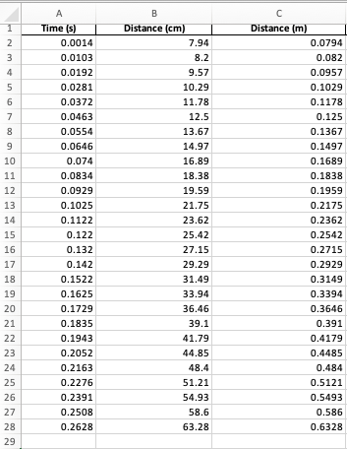
Excel Table
Data table showing time, distance, and converted values in meters for a single trial of free fall.

Slide 17
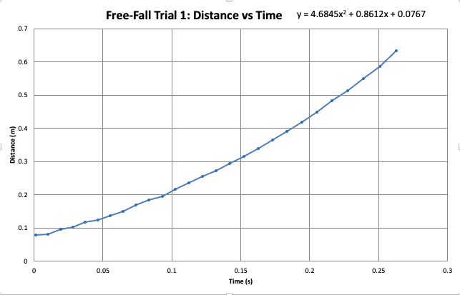
Excel Graph
Distance vs. time graph for free fall. The curve fitting confirms motion follows a quadratic relationship, consistent with constant acceleration.

Slide 18
Data Collection
Trial | x² coefficient value from curve fitting | Acceleration (m/s²) = 2* (x² coefficient)
1 | 4.6845 | 9.37
2 | 4.6327 | 9.27
3 | 4.6925 | 9.38
4 | 4.5634 | 9.13
5 | 4.6093 | 9.22
All five trials produced consistent curve-fitting values, showing repeatability and reliability in the data.

Slide 19


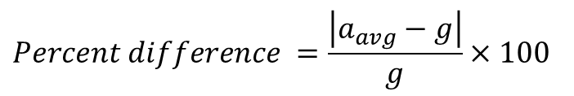
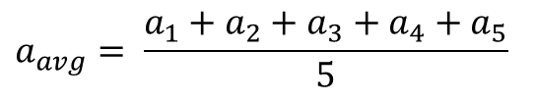
Data Analysis
Average acceleration from table
Percent difference with $g=9.8 m/s^{2}$
$$a_{avg}= \frac{a_{1}+a_{2}+a_{3}+a_{4}+a_{5}}{5}$$
Answer: 9.27
$$m/s^{2}$$
$$Percent difference =\frac{\left|a_{avg}−g\right|}{g}×100$$
Answer: 5.41. %

Slide 20
Overview
The measured accelerations ranged from 9.13 to 9.39 m/s², showing consistent and repeatable results.
The average acceleration of 9.27 m/s² was close to the accepted value of 9.8 m/s², with only a 5.41% difference.
Small variations were likely due to manual timing and reaction delay.
Results validate the theoretical model of free fall and confirm that experimental uncertainty was minimal.

Slide 21
Conservation of Energy of a Free-Falling Object
Verified the principle of conservation of energy during free fall.
Examined the transformation of potential energy (U) into kinetic energy (K).
Compared theoretical and experimental velocities to confirm total energy consistency.

Slide 22
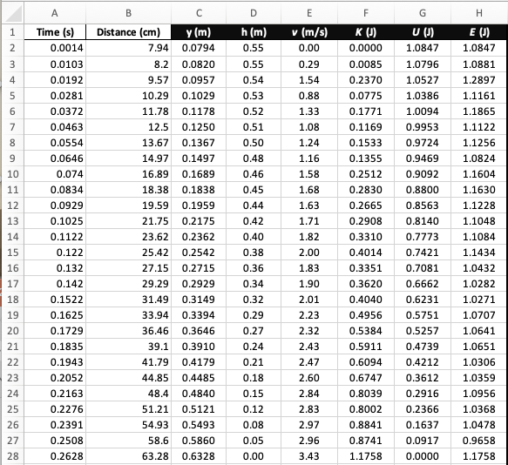
Excel Table
Table shows position, velocity, and energy values throughout a single fall. As the object drops, potential energy decreases while kinetic energy increases, keeping total energy nearly constant.

Slide 23
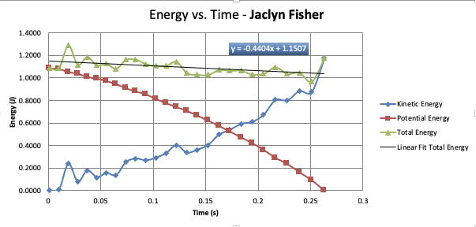
Excel Graph
Graph shows U (potential energy) decreasing and K (kinetic energy) increasing over time, while total energy (E) remains nearly constant. The slight downward slope in E is expected from real-world energy losses such as air resistance and sensor error.

Slide 24

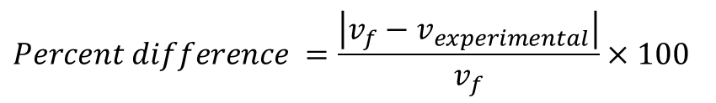


Data analysis
Theoretical value of final velocity
Final velocity from experimental data (or largest velocity)
Percent difference
$h=y_{final}−y_{initial}=$
0.5941
$v_{f}=\sqrt{2gh}=$
3.41
m/s
$v_{experimental}$ =
3.34 m/s
$$Percent difference =\frac{\left|v_{f}−v_{experimental}\right|}{v_{f}}×100$$
Answer: 2.05 %

Slide 25
Overview
Energy transformations matched theory: U decreased while K increased, keeping E ≈ constant.
Theoretical and experimental velocities differed by only 2.05%, showing strong accuracy.
Small downward slope in total energy caused by air resistance, friction, and sensor error.
Results validate the principle of energy conservation in free fall.

Slide 26
Relationship Between Linear and Rotational Motion
Explored how rotational motion translates into linear distance.
Applied encoder data to calculate motion and compared results with direct ruler measurements.
Evaluated the accuracy of the encoder’s resolution in practical applications.

Slide 27

Data Collection
Object diameter: d = 7.00 cm
Object radius: r = 3.50 cm
Number of pulses for one revolution: x = 40
Resolution = $\left(\frac{1 }{x } \frac{Revolution}{pulses}\right)∙\left(\frac{2∙π radians}{1 Revolution}\right)=$ 0.157 Rad/pulse

Slide 28
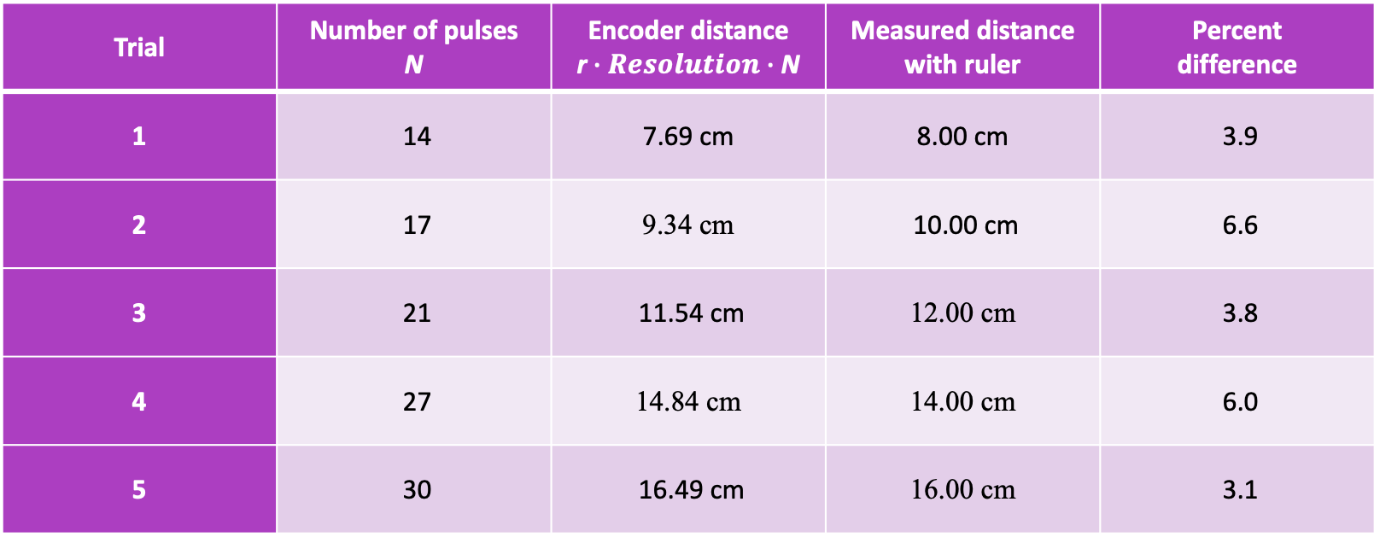
Data Analysis
Trial | Number of pulses N | Encoder distance r$∙Resolution∙$ N | Measured distance with ruler | Percent difference
1 | 14 | 7.69 cm | 8.00 cm | 3.9
2 | 17 | 9.34 cm | 10.00 cm | 6.6
3 | 21 | 11.54 cm | 12.00 cm | 3.8
4 | 27 | 14.84 cm | 14.00 cm | 6.0
5 | 30 | 16.49 cm | 16.00 cm | 3.1
Encoder distances ranged from 7.69 cm to 16.49 cm.
Ruler measurements ranged from 8.00 cm to 16.00 cm.
Percent differences across five trials were 3.1%–6.6%, showing strong agreement.

Slide 29
Overview
Encoder measurements closely matched ruler values, with differences under 7%.
Small errors likely came from surface friction, slight rolling variations, and ruler reading error.
Demonstrates that the arc length formula (s = rθ) accurately translates rotational pulses into linear distance.
Applications: robotics wheel travel, conveyor belt monitoring, sports equipment testing. On uneven surfaces, accuracy decreases since the model assumes a flat, consistent contact path.

Slide 30
Observing the Hall Effect
Studied how magnetic fields influence moving charges using Hall sensors.
Demonstrated the sensor’s ability to detect both polarity and field strength.
Connected experimental findings to real-world technologies in automotive, electronics, and robotics.

Slide 31
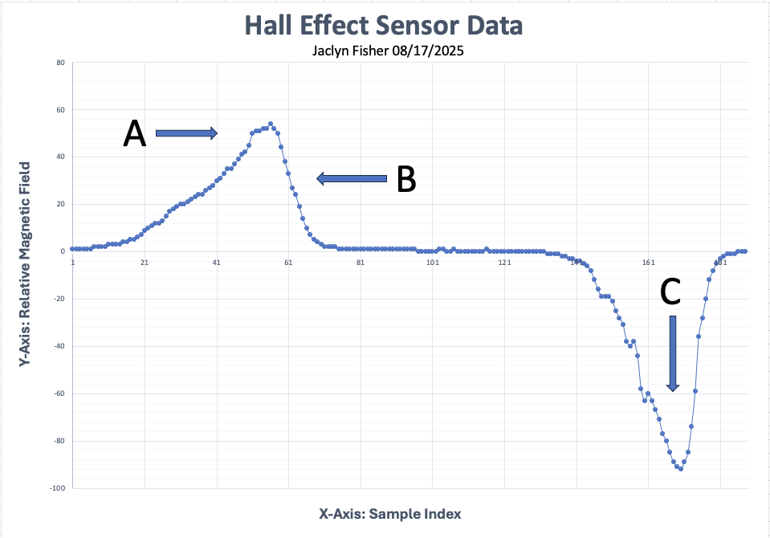
Hall Effect sensor readings as a function of sample index.
Region A: shows the magnet moving toward the ESP32.
Region B: shows the magnet moving away.
Region C: shows the magnet flipped and moved toward again, producing negative polarity.

Slide 32
Overview
The Hall sensor detected not just the strength of the magnetic field, but also its direction, flipping output when polarity reversed.
Data confirmed the Hall Effect in action: voltage changes were proportional to the magnet’s movement and orientation.
Results validate Hall sensors as reliable tools for converting invisible magnetic fields into measurable electrical signals - the foundation for their wide use in modern technology.

Slide 33
Challenges
Extracting valid results from provided data
Managing complex formulas and precise calculations
Maintaining consistency with units and significant figures
Presenting results clearly for both technical and general audiences

Slide 34

Career Skills
Strengthened ability to analyze experimental data using structured methods and formulas.
Gained experience applying digital tools like Excel and the Desmos Calculator for calculations, graphing, and interpreting results.
Built problem-solving skills by working through multi-step physics problems and validating results against accepted values.
Developed clearer scientific communication by presenting findings in tables, graphs, and concise explanations.

Slide 35
References
Dejan. (2017, April 13). Ultrasonic sensor HC-SR04 and Arduino - Complete guide. How To Mechatronics. https://howtomechatronics.com/tutorials/arduino/ultrasonic-sensor-hc-sr04/?utm
Robbins, H. (2024, November 4). What are hall effect sensors and how do they work? WIRED. https://www.wired.com/story/what-is-hall-effect/
ADMIN. (2023, December 30). Introduction to the KY-040 Rotary Encoder. https://electronca.com/electronics/what-is-ky-040-rotary-encoder-module-how-to-use-it/
DeVry University. (2025). Final course project instructions for PHYS204: Physics with Lab [Unpublished course materials]. Canvas.

